Slide 1
#Goal 1: variable importance plot and aic table of all models
#Goal 2: Hypothesis testing
    H1: bottomup regulation: prey->growth (ncc), growth->abund (cpue, sar), akprey->sar (ak)
    H2: topdown regulation: pred->cpue (ncc), pred ->sar (ak), akprey->sar (ak)
    H3: indirect effects (alt prey and habitat compression index):
    pred*(1-prey (ncc, ak)) * (1- pred*spatial overlap (HCI, SST))
#Goal 3: alternate explanations (temp and prey*pred scenarios)

Slide 2
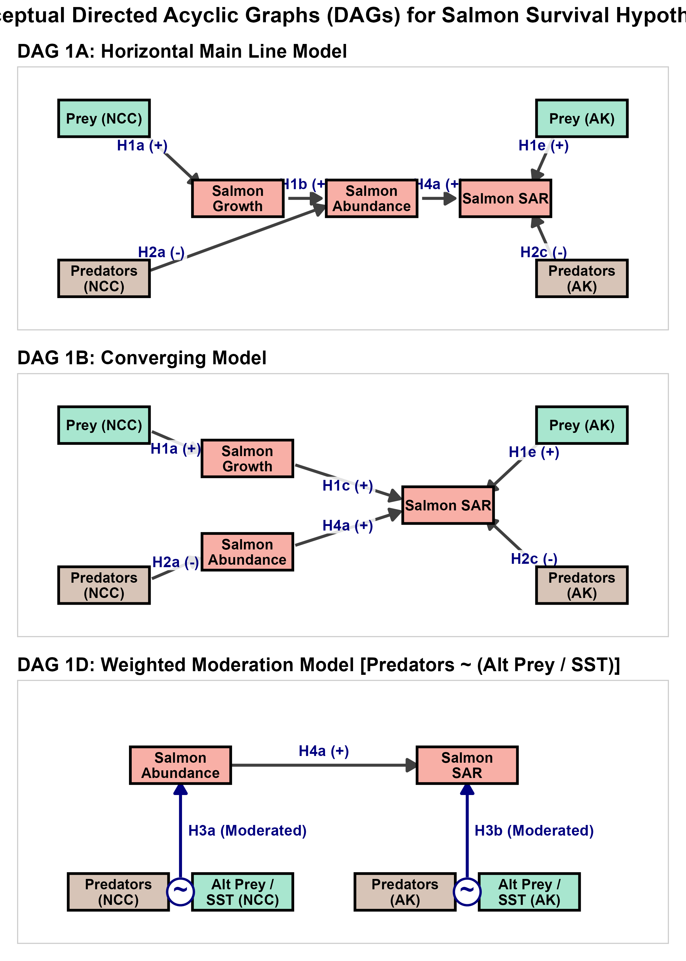

Slide 3
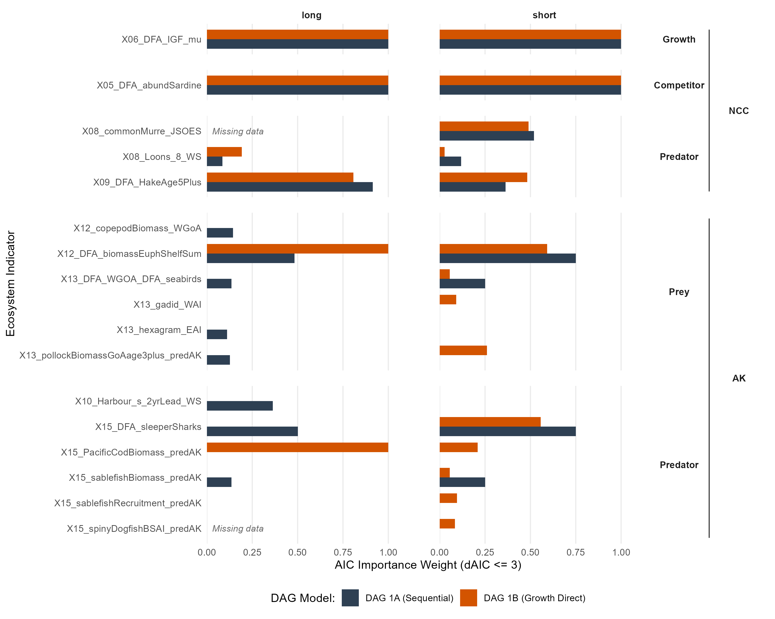
Goal1: Variable reduction
Takeaways:
A few terms did best (strong support)
Sardine/herring -> IGF
Hake or murre -> cpue
Krill +
Sleeper sharks or Pcod -> SAR
Variable importance plot

Slide 4
Goal 2: Hypothesis testing
Top 100 models by aic

Slide 5
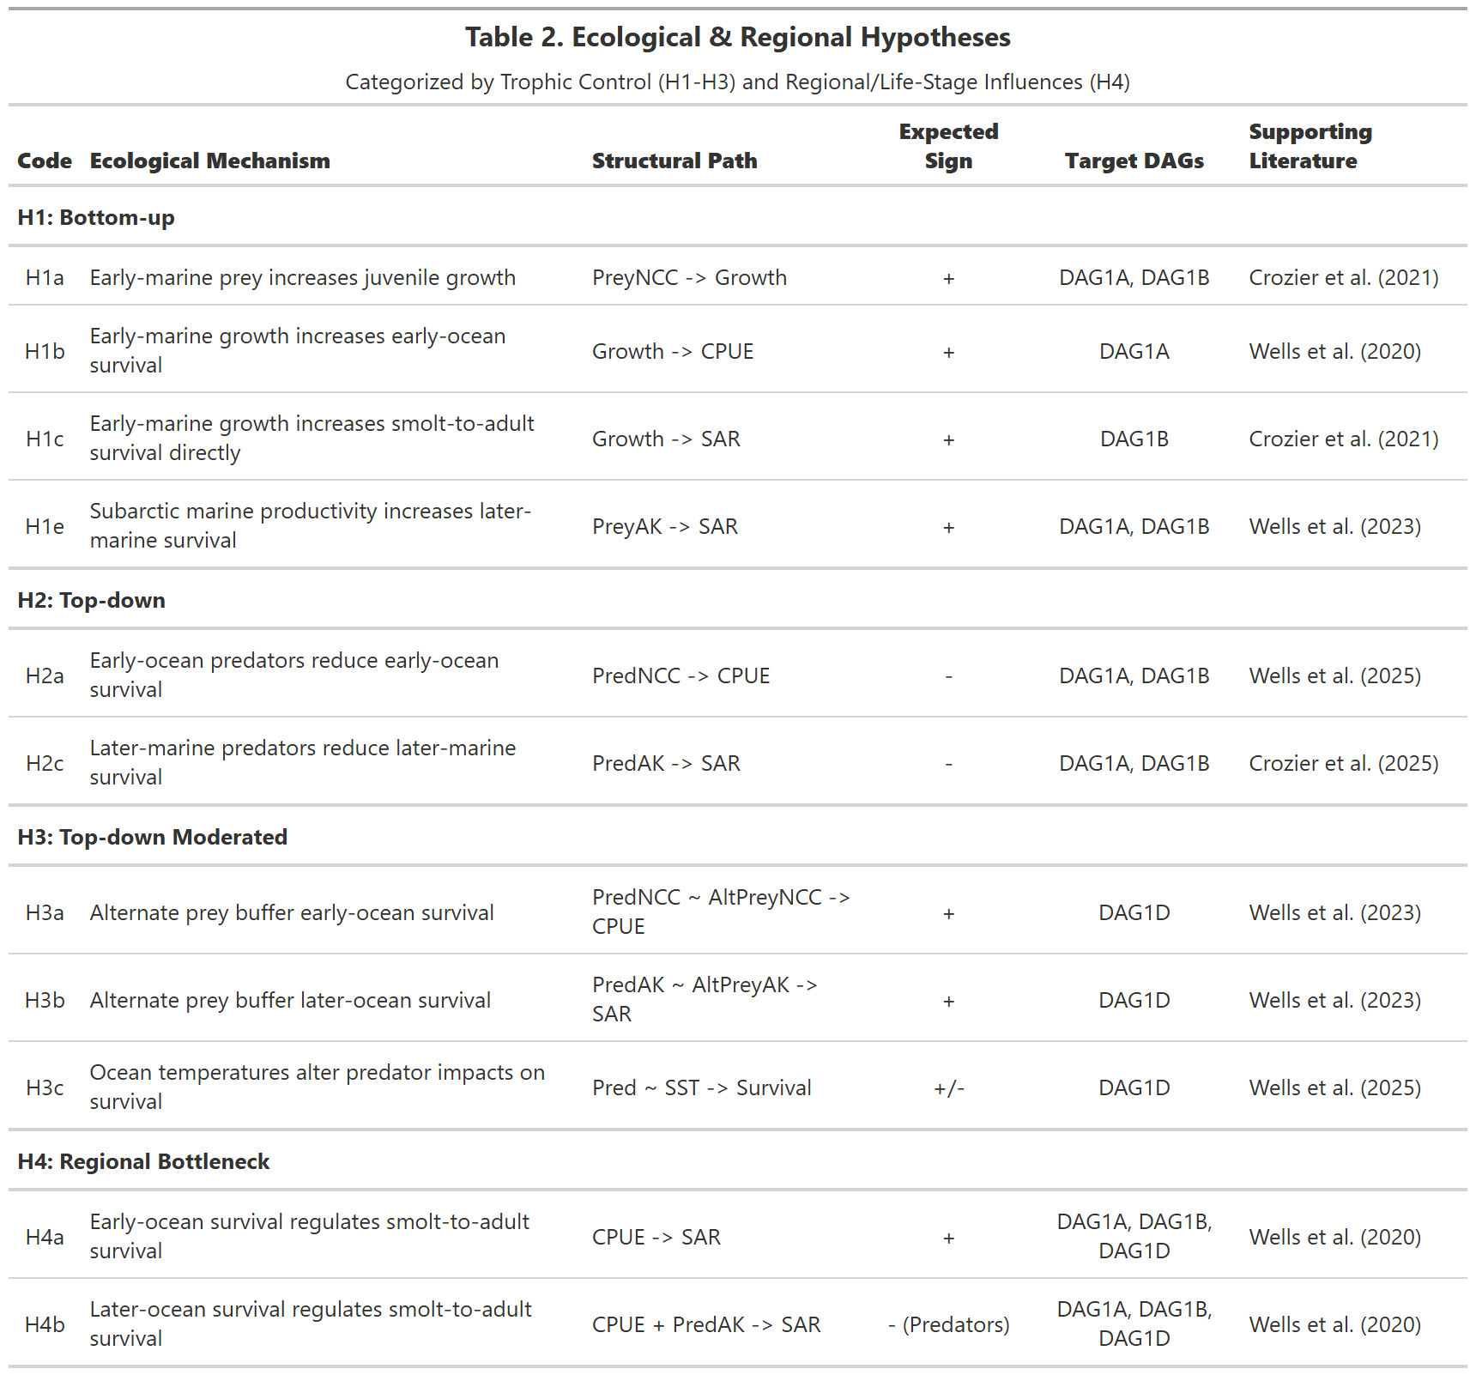

Slide 6
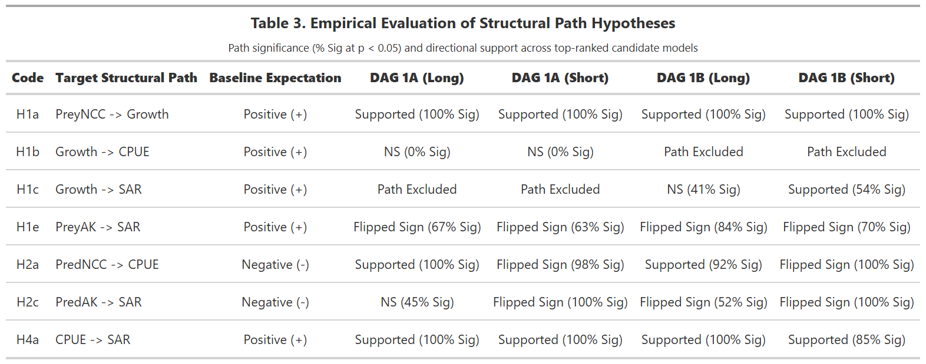
The requirement is for >50% to be significant, and support is the majority sign (>50%)
Plankton (+)
Herring(+)
Sardine (-)
WCVI krill (-)
Herring(+)
Sardine (-)
Supported:
NCC prey-growth-sar and cpue-sar right direction, generally supported (note, sign matches herring instead of sardine)
NCC pred-cpue depends on predator (murre vs seals)
Not supported:
Growth-cpue NS, growth-sar inconsistent
AK prey-SAR always flipped sign
PredAK-SAR always flipped sign or NS

Slide 7
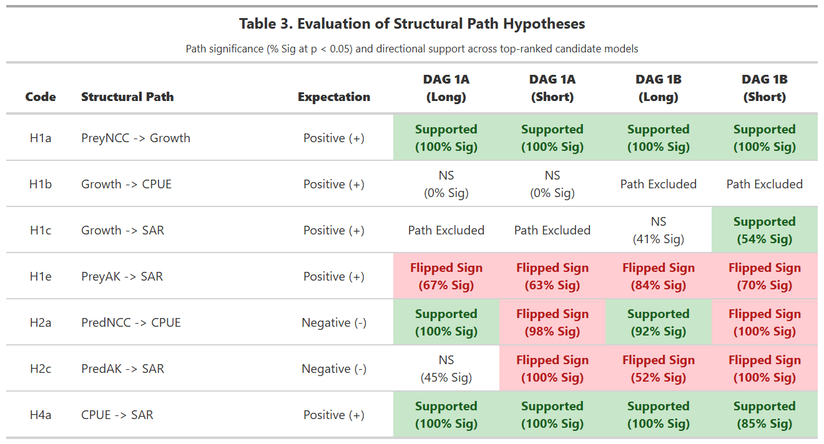
Plankton (+)
Herring(+)
Sardine (-)
WCVI krill (-)
Hake (-)
Murre (+)

Slide 8
Study System
Our model focuses on interactions that affect Interior Columbia spring Chinook salmon in either their early-ocean stage within the Northern California Current (NCC), followed by the 1-3 years they spend in the Gulf of Alaska or even the Bering Sea through their return as adults to the Columbia River. Our life history model is based on individual tracking studies, ocean surveys that target juvenile salmon off the coast of Washingon, British Columbia and Alaska, recoveries of tagged fish in ocean fisheries, and genetic stock identification of ocean-caught spring Chinook salmon. We focus specifically on Snake River Spring/Summer-run Chinook salmon and Upper Columbia Spring Chinook salmon Evolutionarily Significant Units, which are listed as threatened and endangered, respectively, under the U.S. Endangered Species Act [ref].
is a highly productive coastal ecosystem in the northeastern Pacific Ocean (Hickey & Banas, 2008).
We focus on the region from northern Oregon, U.S.A., to southern British Columbia, Canada, which is particularly important for Pacific salmon and steelhead (Oncorhynchus spp.) from the Pacific Northwest.
Our conceptual models reflect what is known about the early marine stage of spring-run Chinook salmon that spawn across a wide range of habitats from coastal Washington to the mountains of Idaho. Chinook salmon enter the ocean in their first (“subyearling”) or second (“yearling”) year and spend 1 to 3+ years at sea before returning to natal streams to spawn. Spring-run smolts migrate quickly through the NCC to Alaskan waters using an offshore route, while fall-run smolts stay nearer to shore and travel more slowly along the coast (Anderson et al., 2019; Fisher et al., 2014). Many of these populations are listed as threatened under the U.S. Endangered Species Act (NMFS, 2022b).

Slide 9
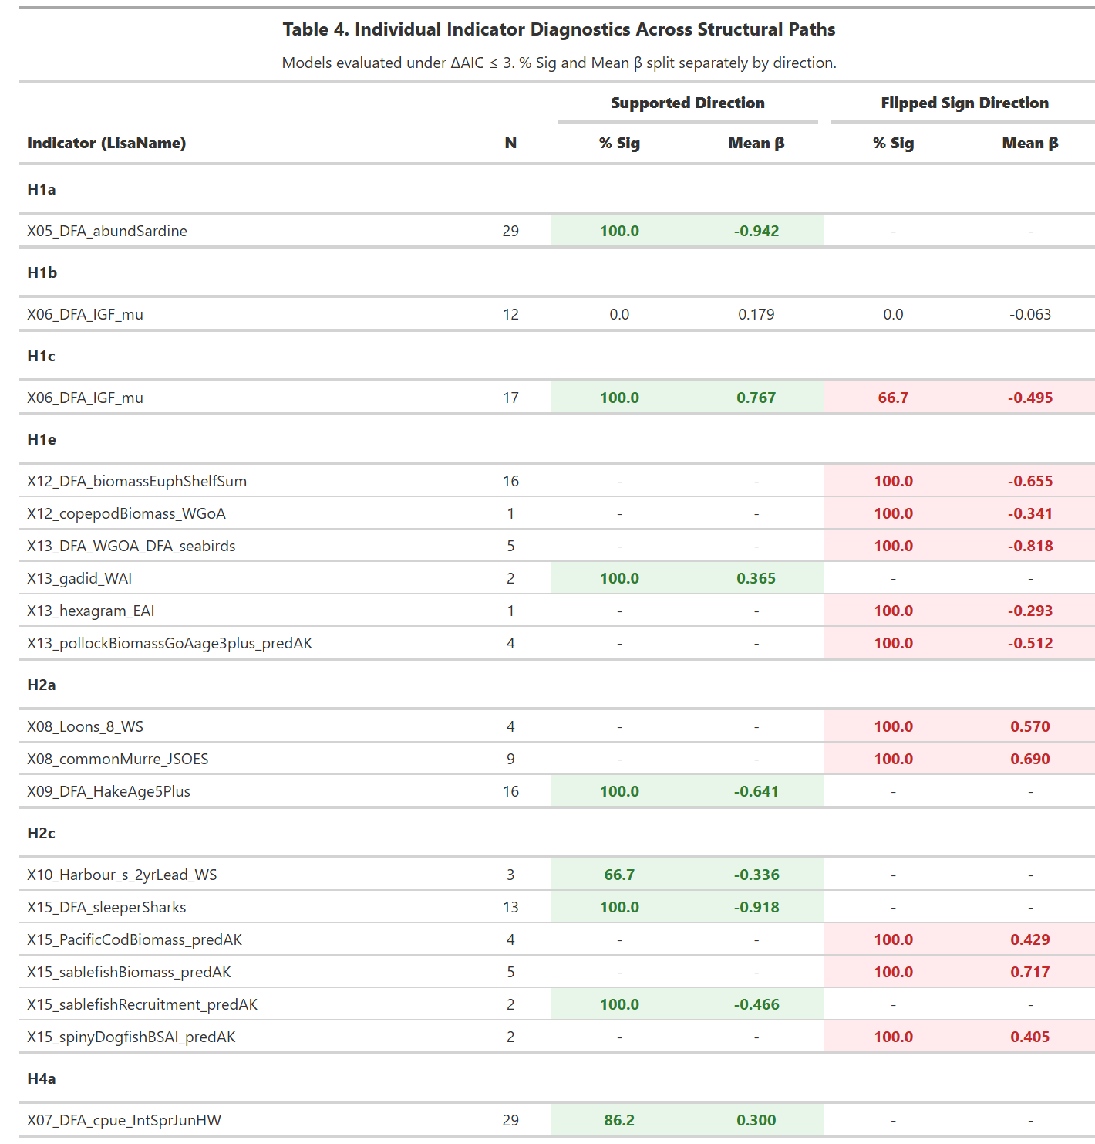
Lisa – check this:
DAG1b short (+)
DAG1b long (-)
Suggestion: drop all of the straggler plankton X12 and X13 and just use Ferris DFA
Separate mid-trophic and lower-trophic so we still have the mixed signal
Takeaways:
Mixed signal on PreyAK and Pred (NCC & AK) means it is not a general productivity message. Rather specific predators respond to specific prey (maybe also SST) which then is either a proxy or a modulating factor in impacting salmon
Birds (+)
Fish (-)
Lag in peak drives diff in sablefish recruitment v biomass

Slide 10
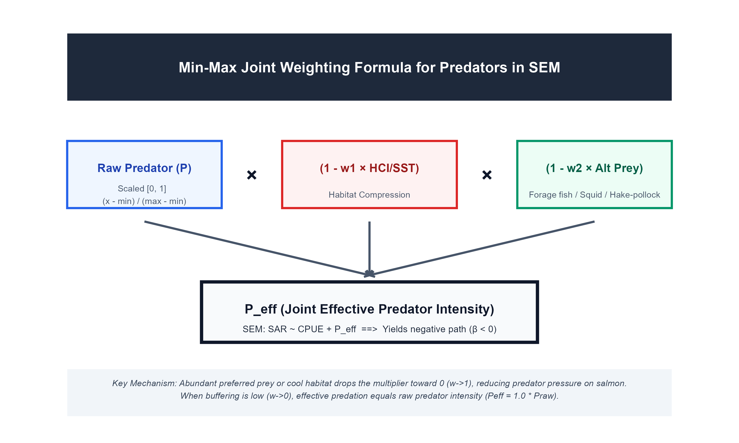

Slide 11
Abundant cool water (<12C)
Much less cool water
2013
2014
Fig. 1 Upwelling habitat compression index, 1980–2016 (2m surface temperature, derived from data-assimilative oceanographic model). a difference
in onshore (0–50 km) and offshore (51–150 km) temperature gradients (average of March–May) as a function of latitude off California (b) time series
describing change in area of cool 12 °C water during early March and May; the long-term mean and standard deviation provides basis for assessing the
relative amount of cool surface water habitat and likelihood of cool water expansion vs. habitat compression, where values above+ 1 SD indicate enhanced
cool ocean conditions (i.e., La Niña or strong upwelling) and below −1 SD indicate no available cool habitat (e.g., El Niño or delayed upwelling); c, d spatial
depiction of the change of cool water habitat during March and May during preceding (2013) and during (2014–2016) the marine heatwave and El Niño;
the thin black line represents the 12 °C contour and area represents the number of pixels with values ≤12 °C. Source data are provided within the Source
Data file.

Slide 12
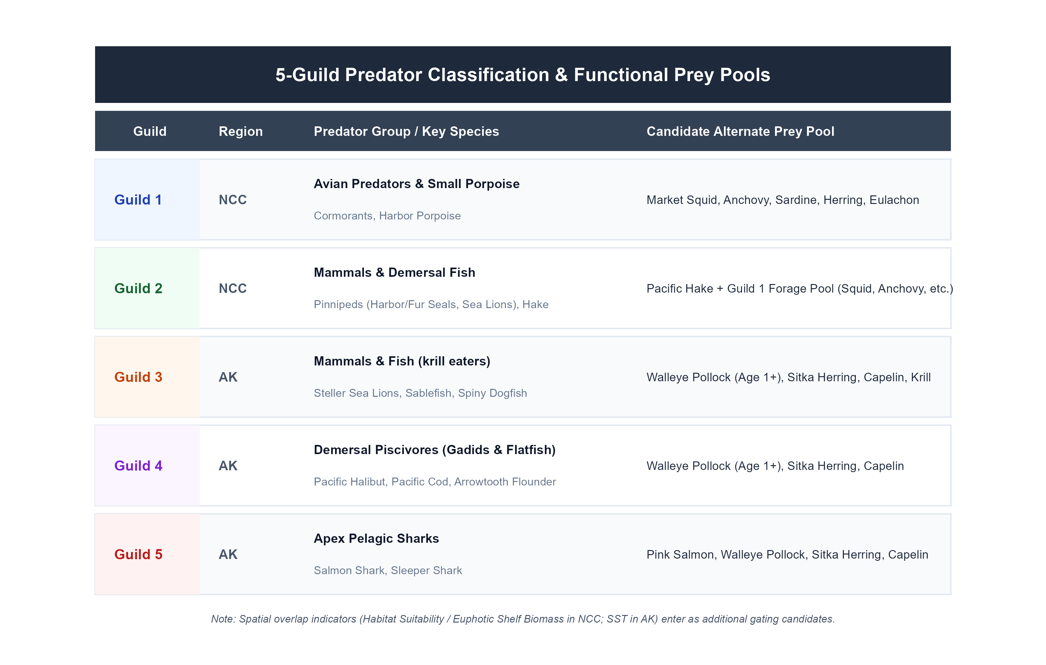

Slide 13
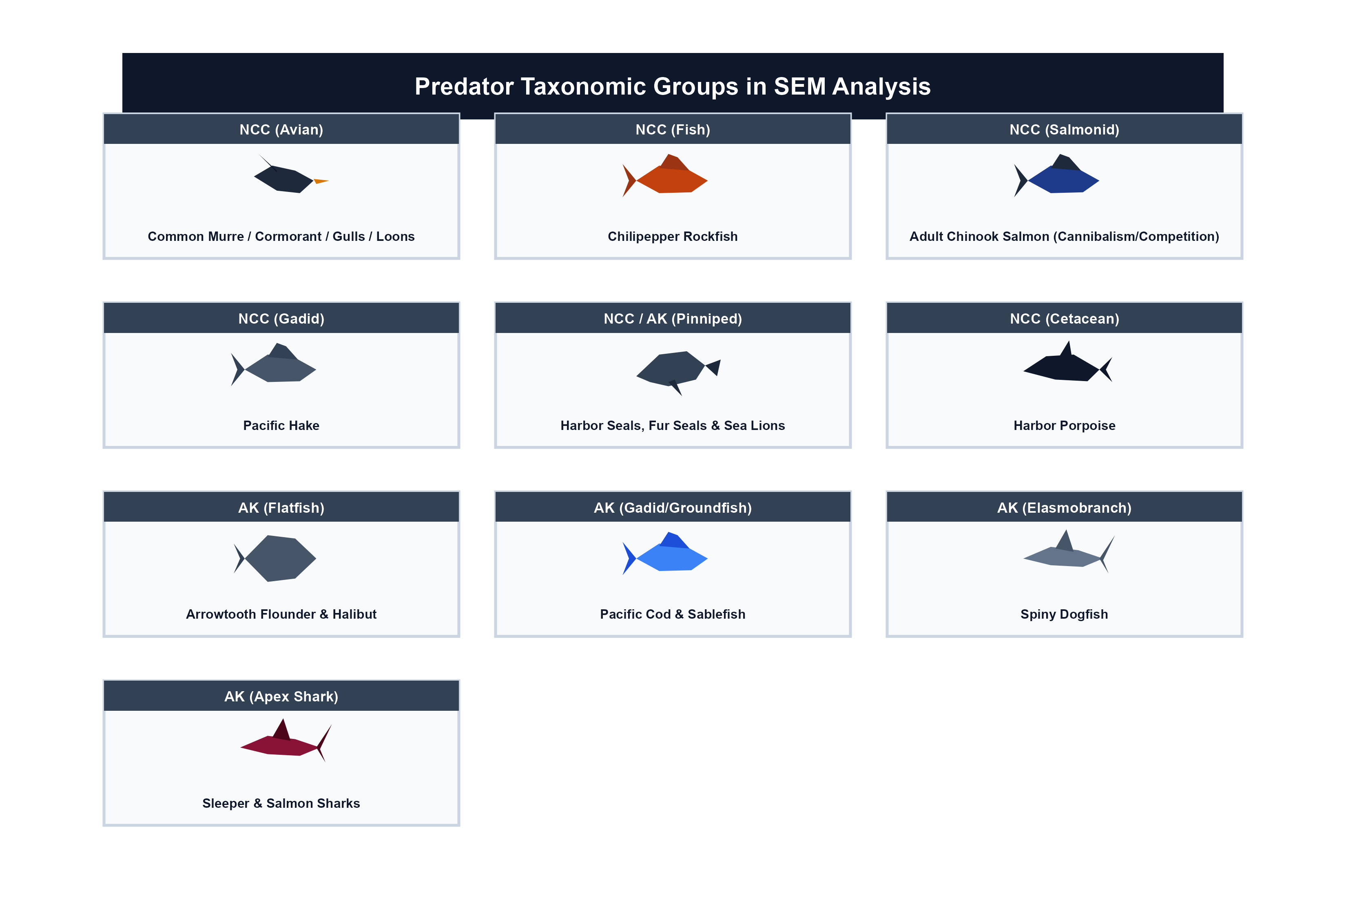

Slide 14
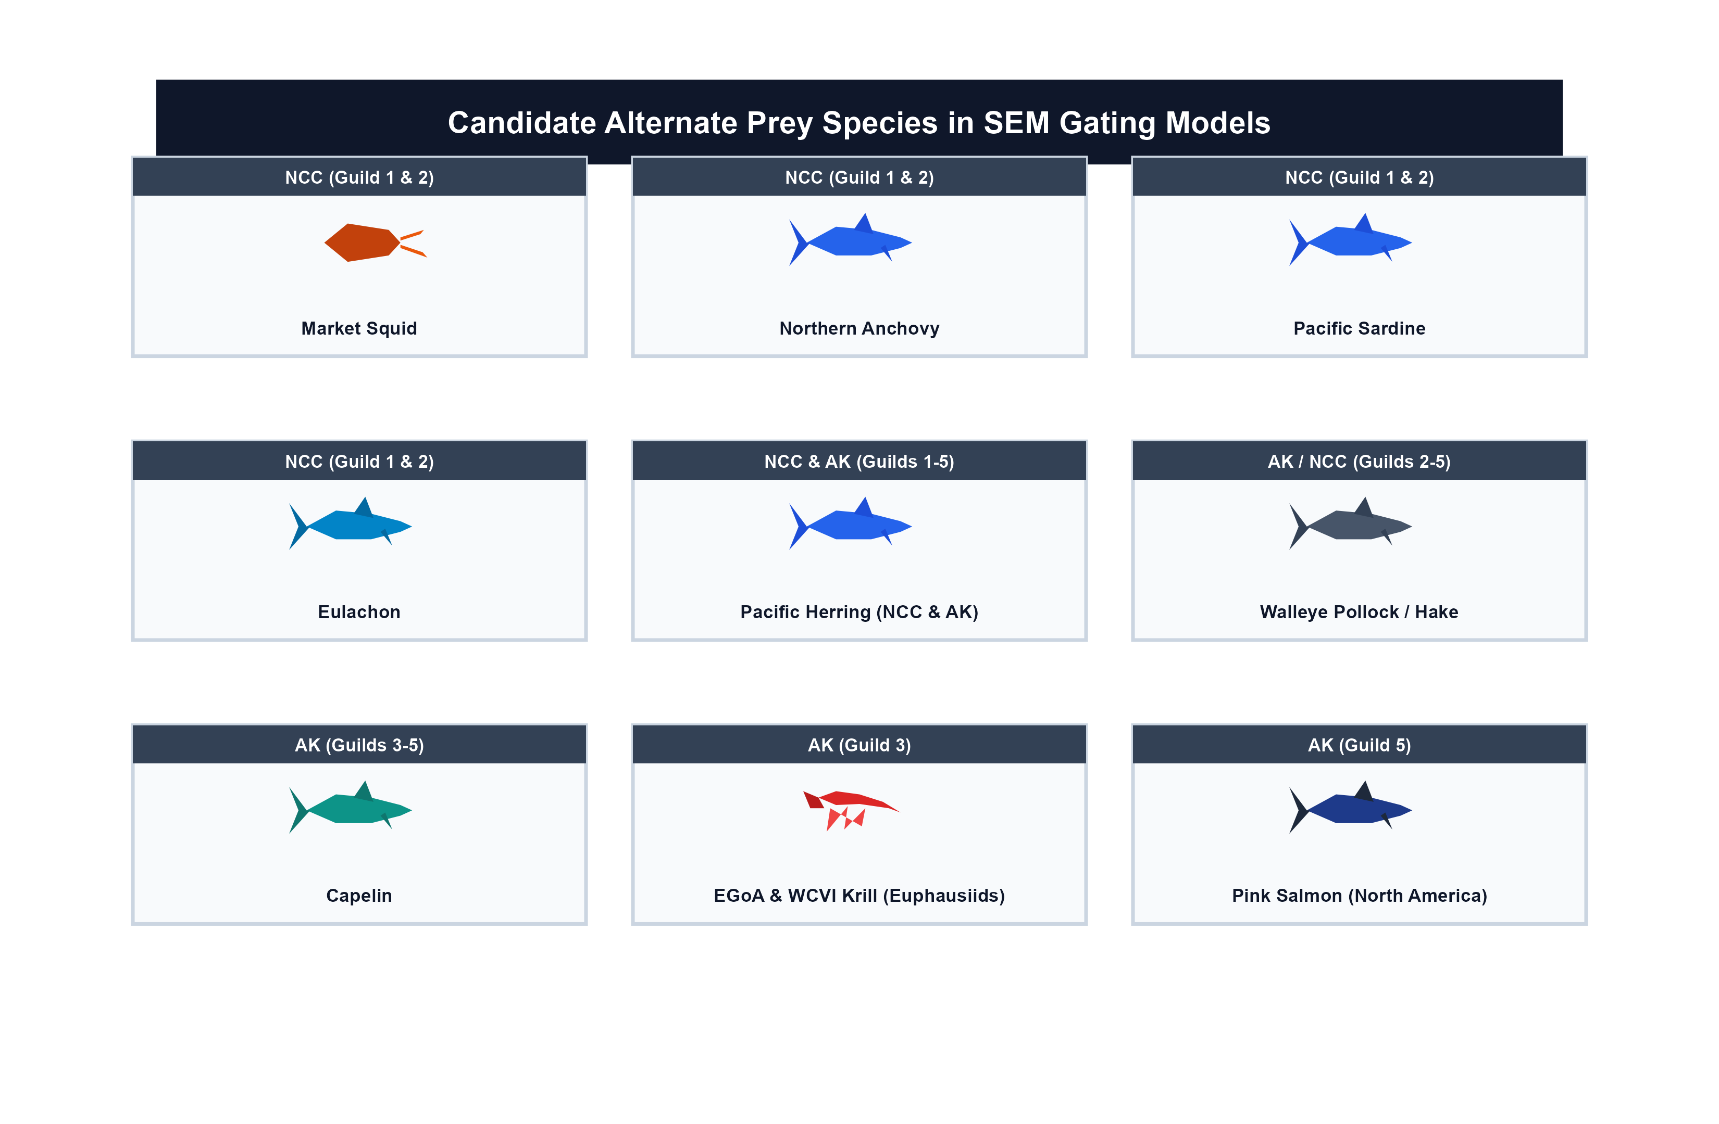

Slide 15
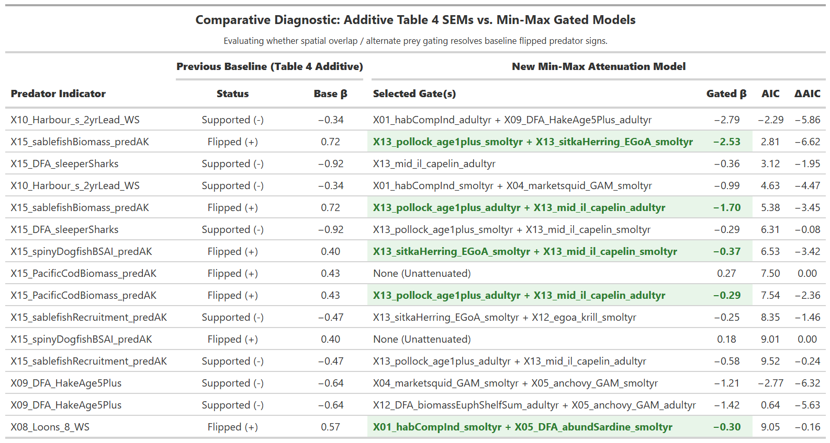
24yr model: almost all models with altprey had negative predator coef (despite pos previously)

Slide 16
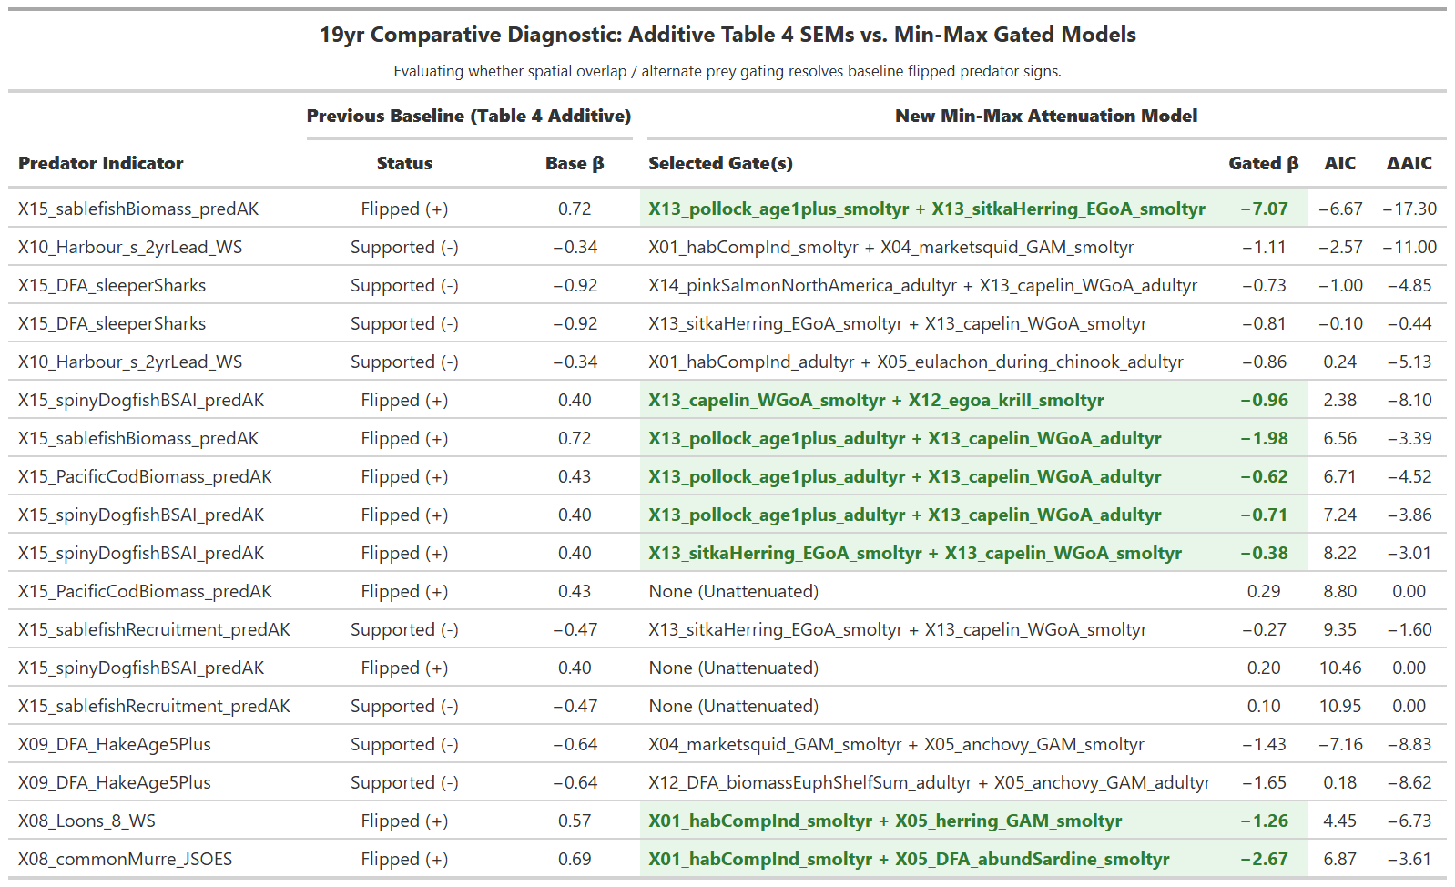

Slide 17
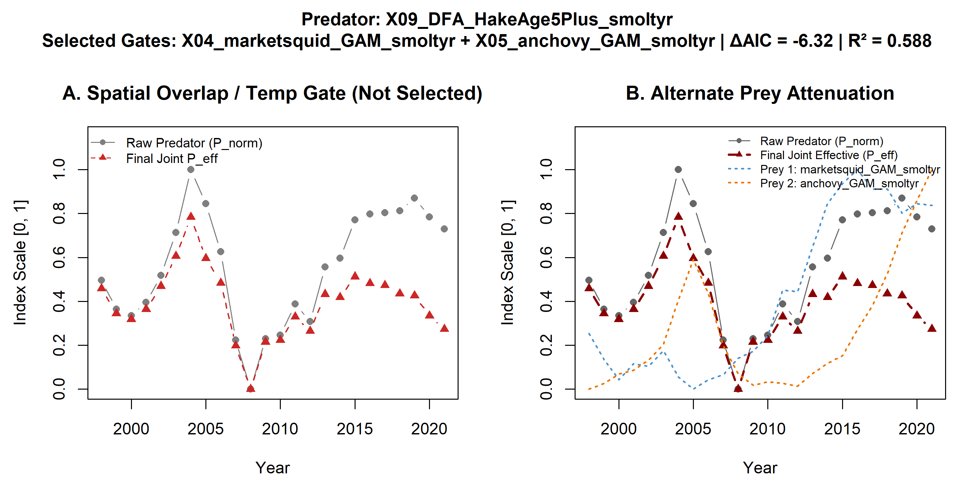
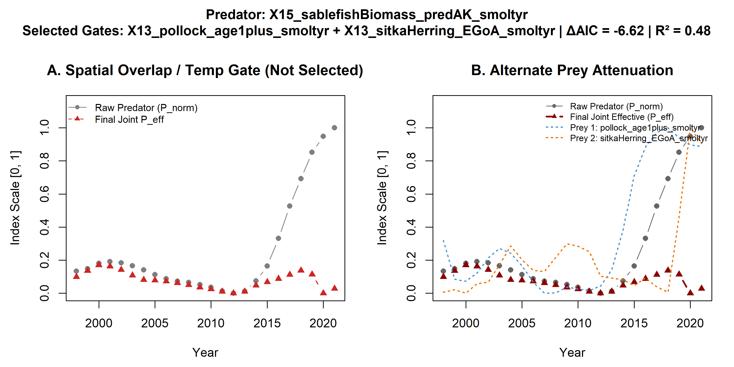
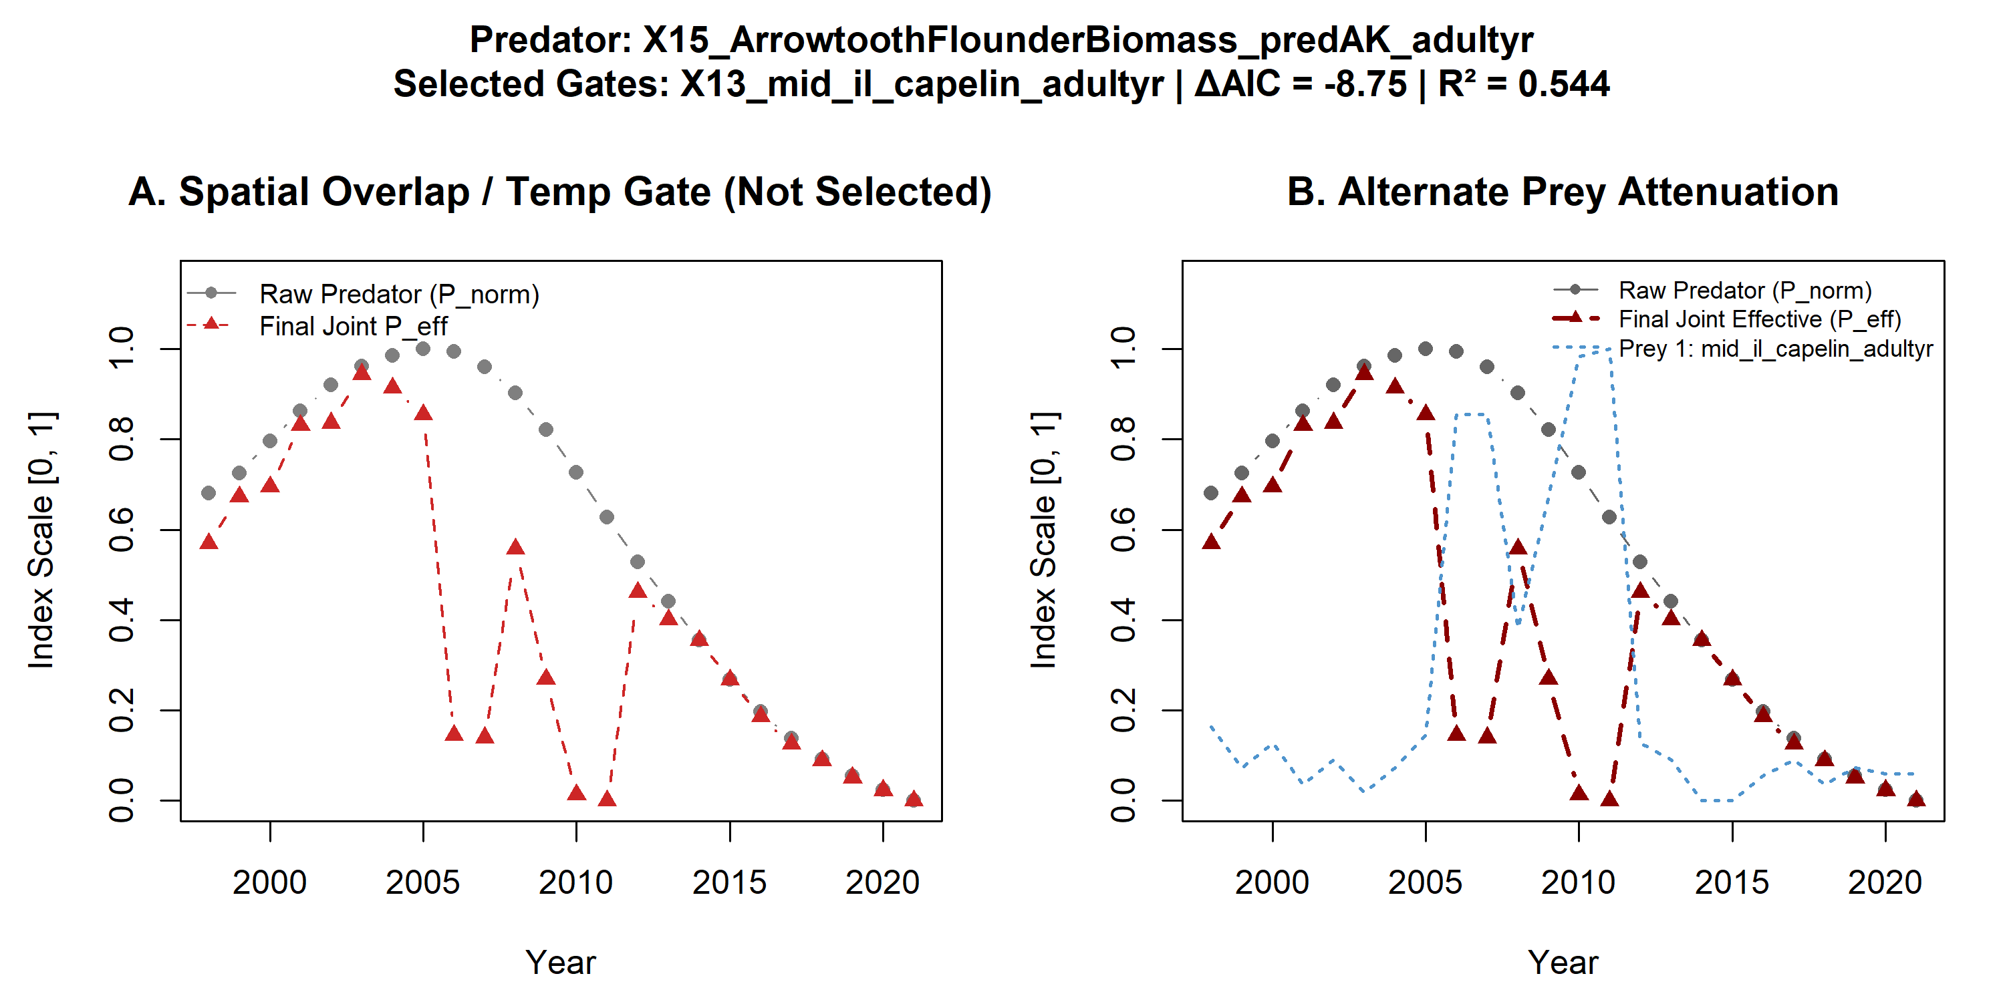
Fish predators on smolts – no temperature effects

Slide 18
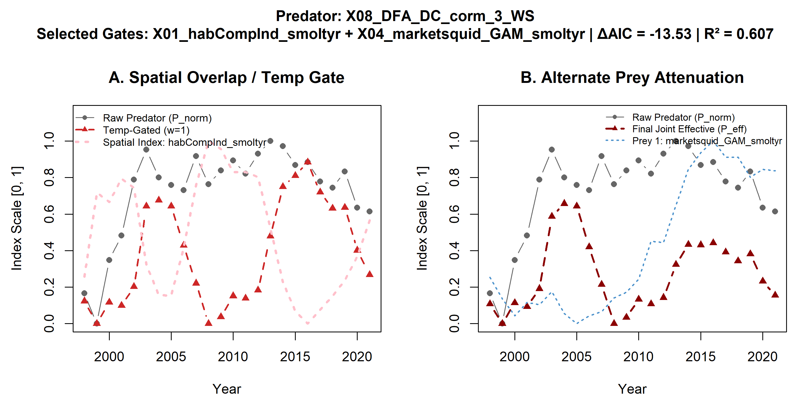
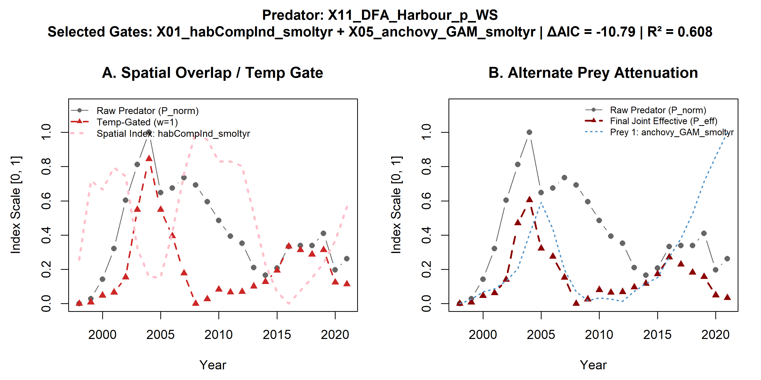
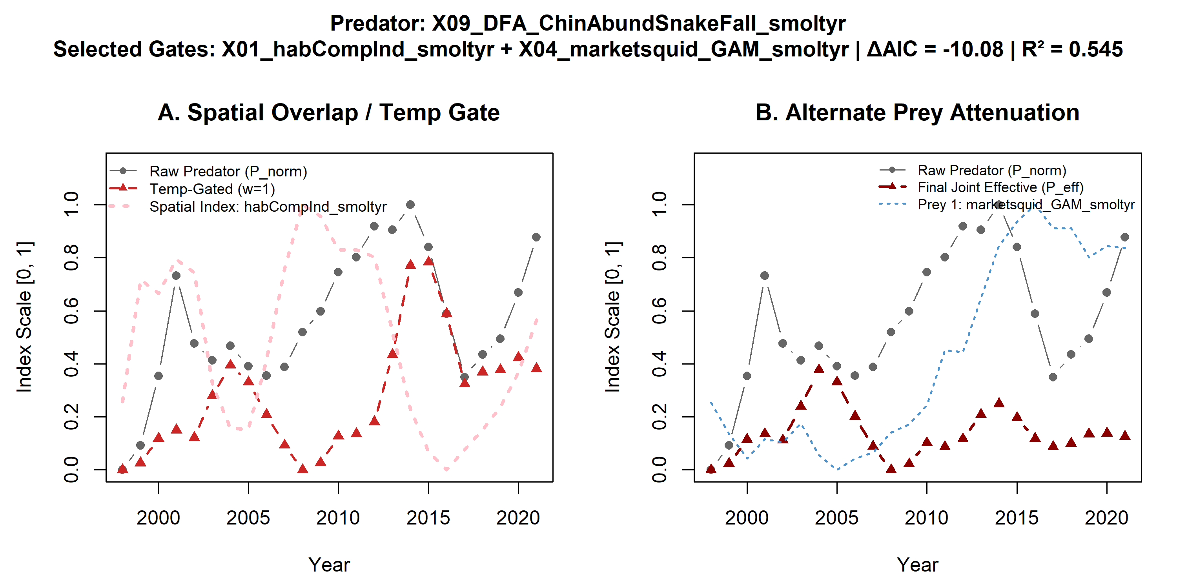
Smolt predators with temperature & altprey

Slide 19
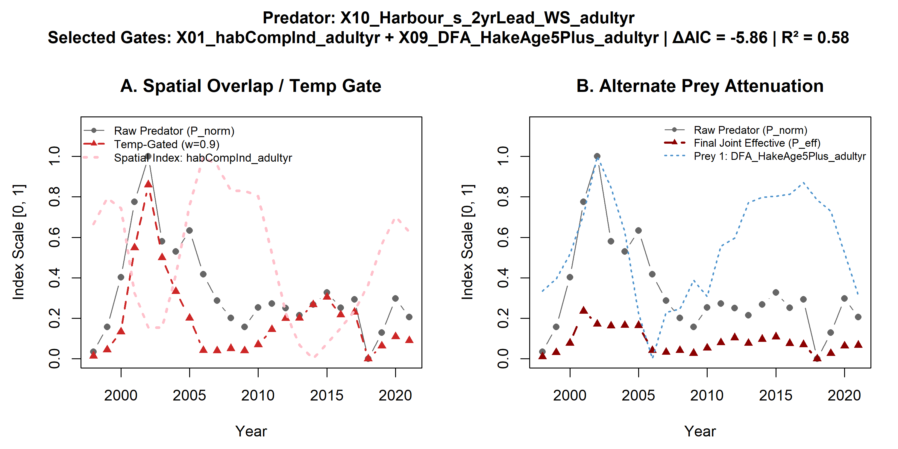
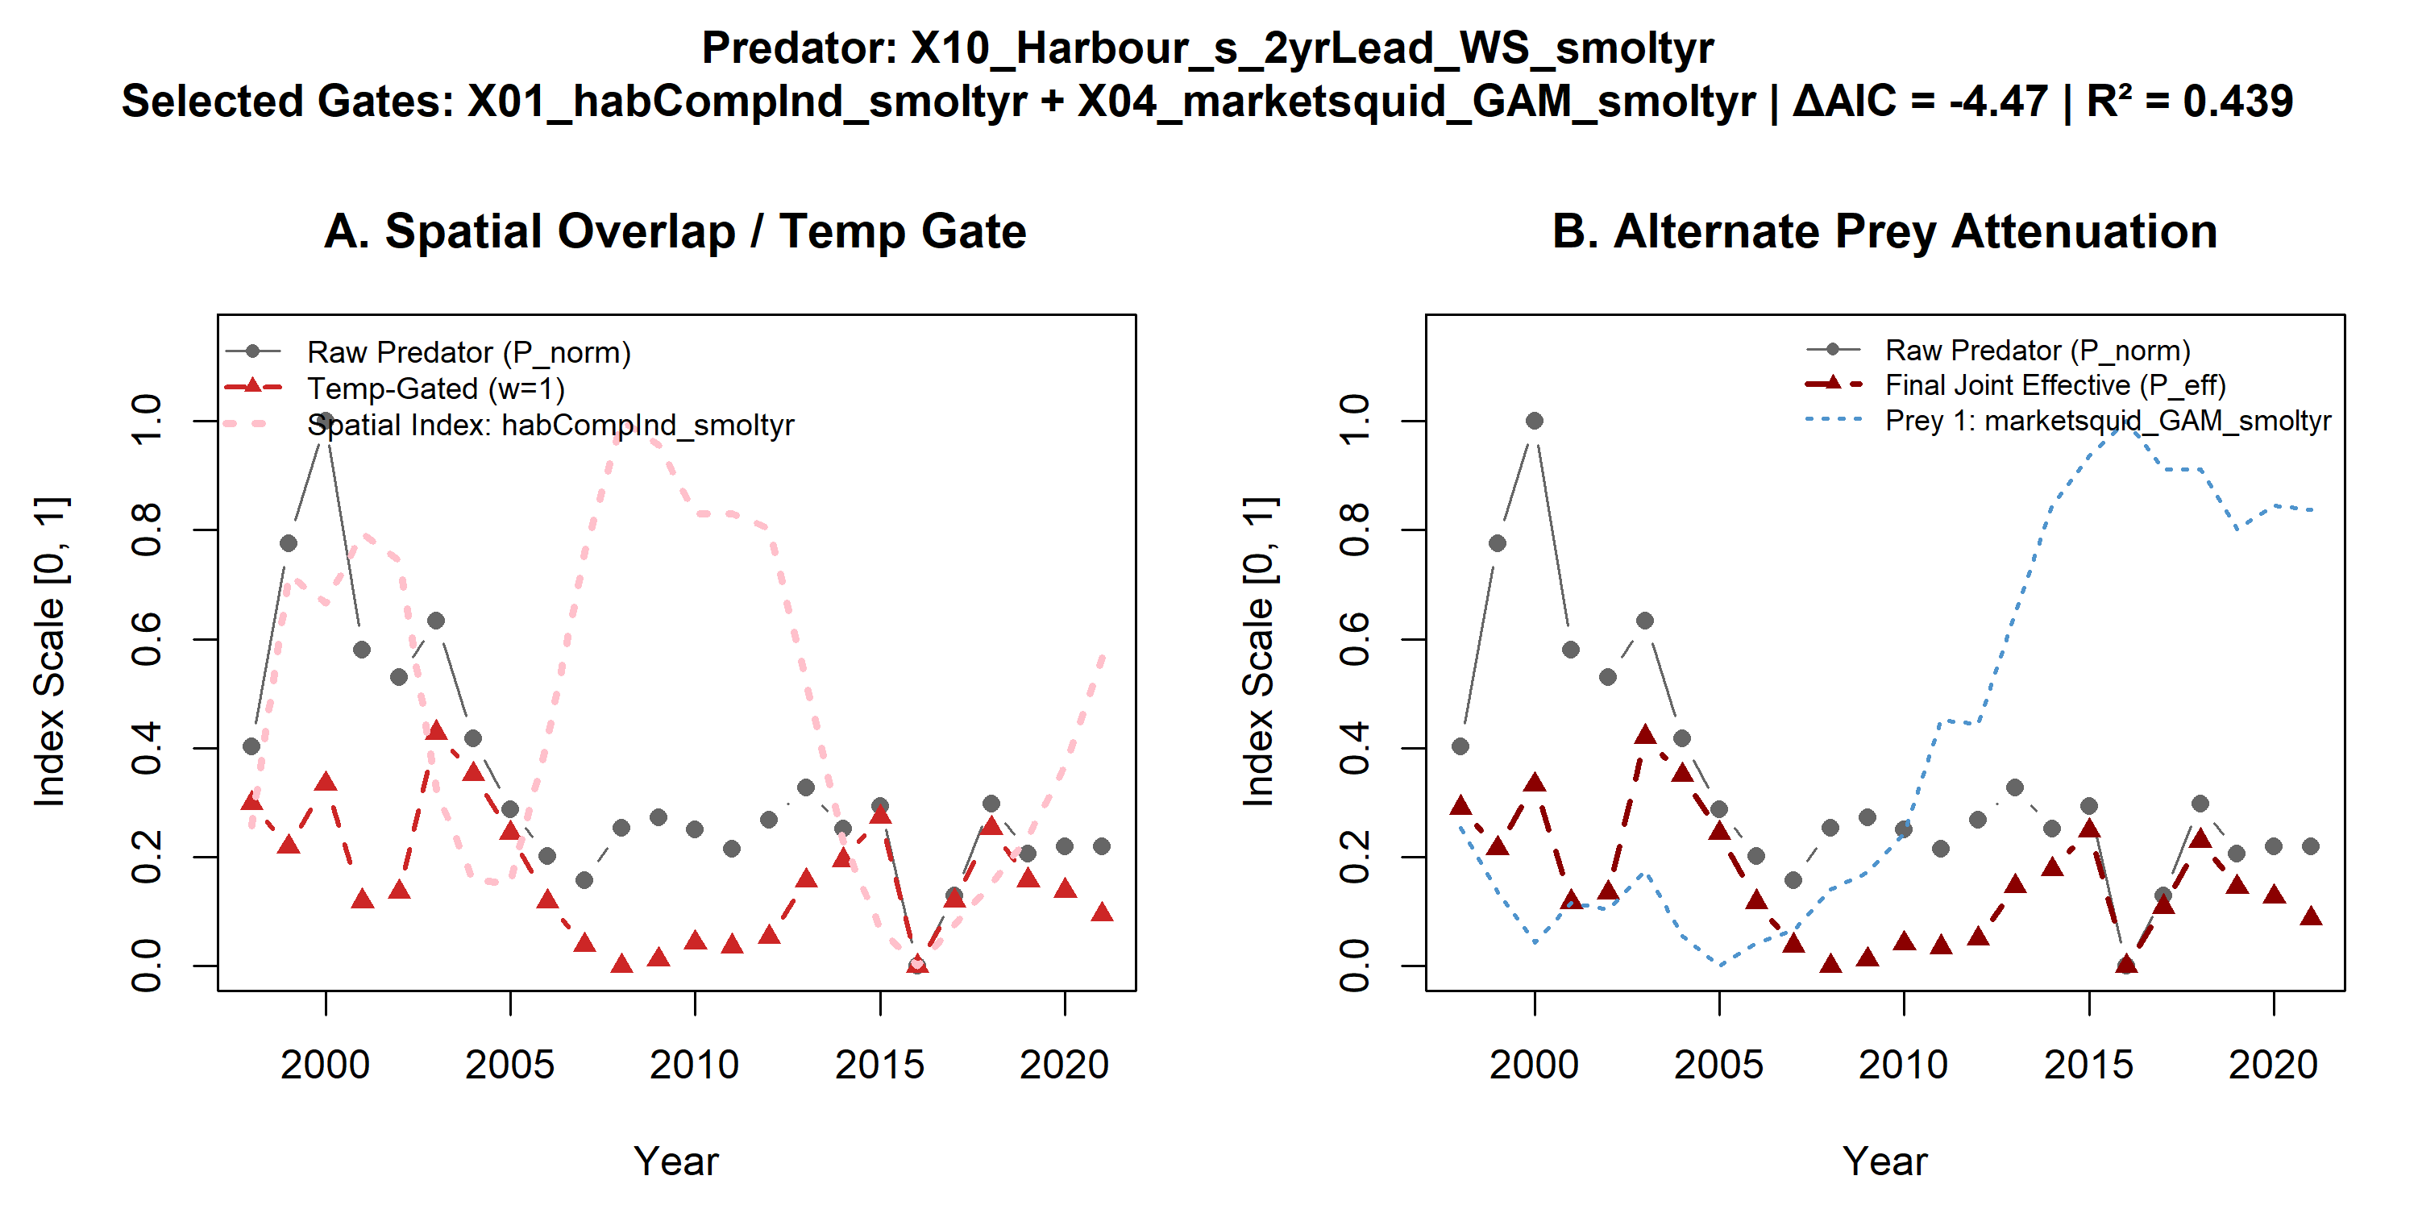
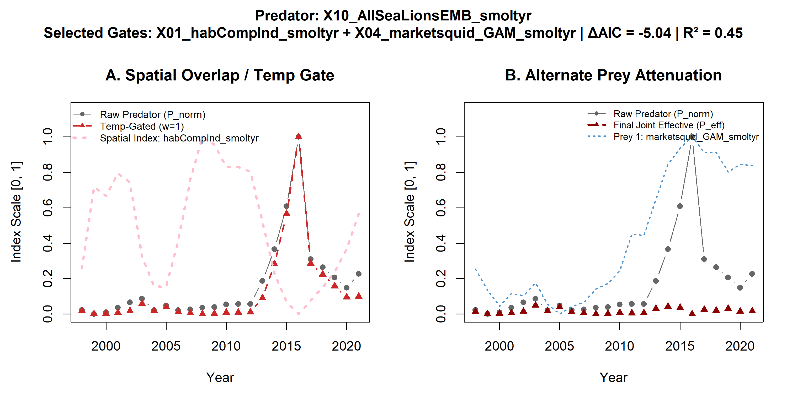
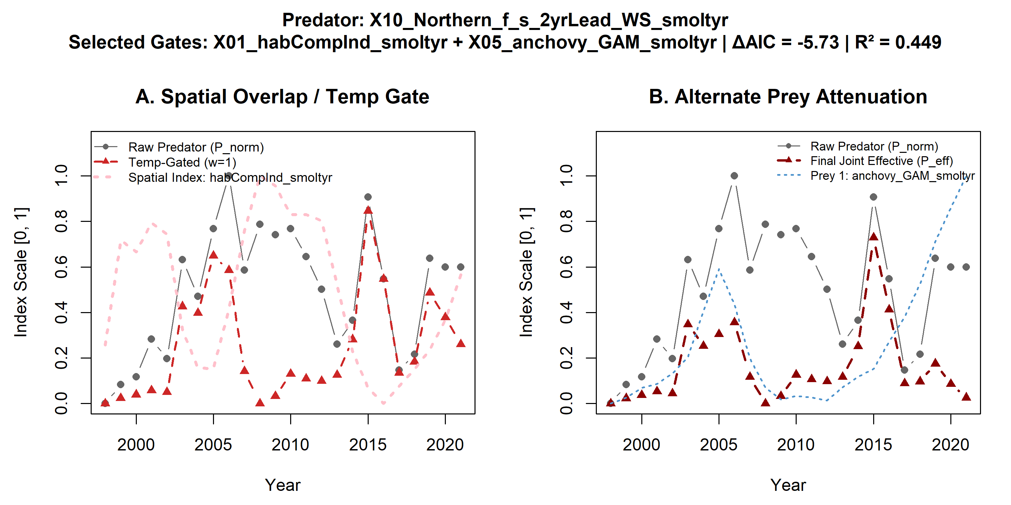
Mammal predators on adult Chinook

Slide 20
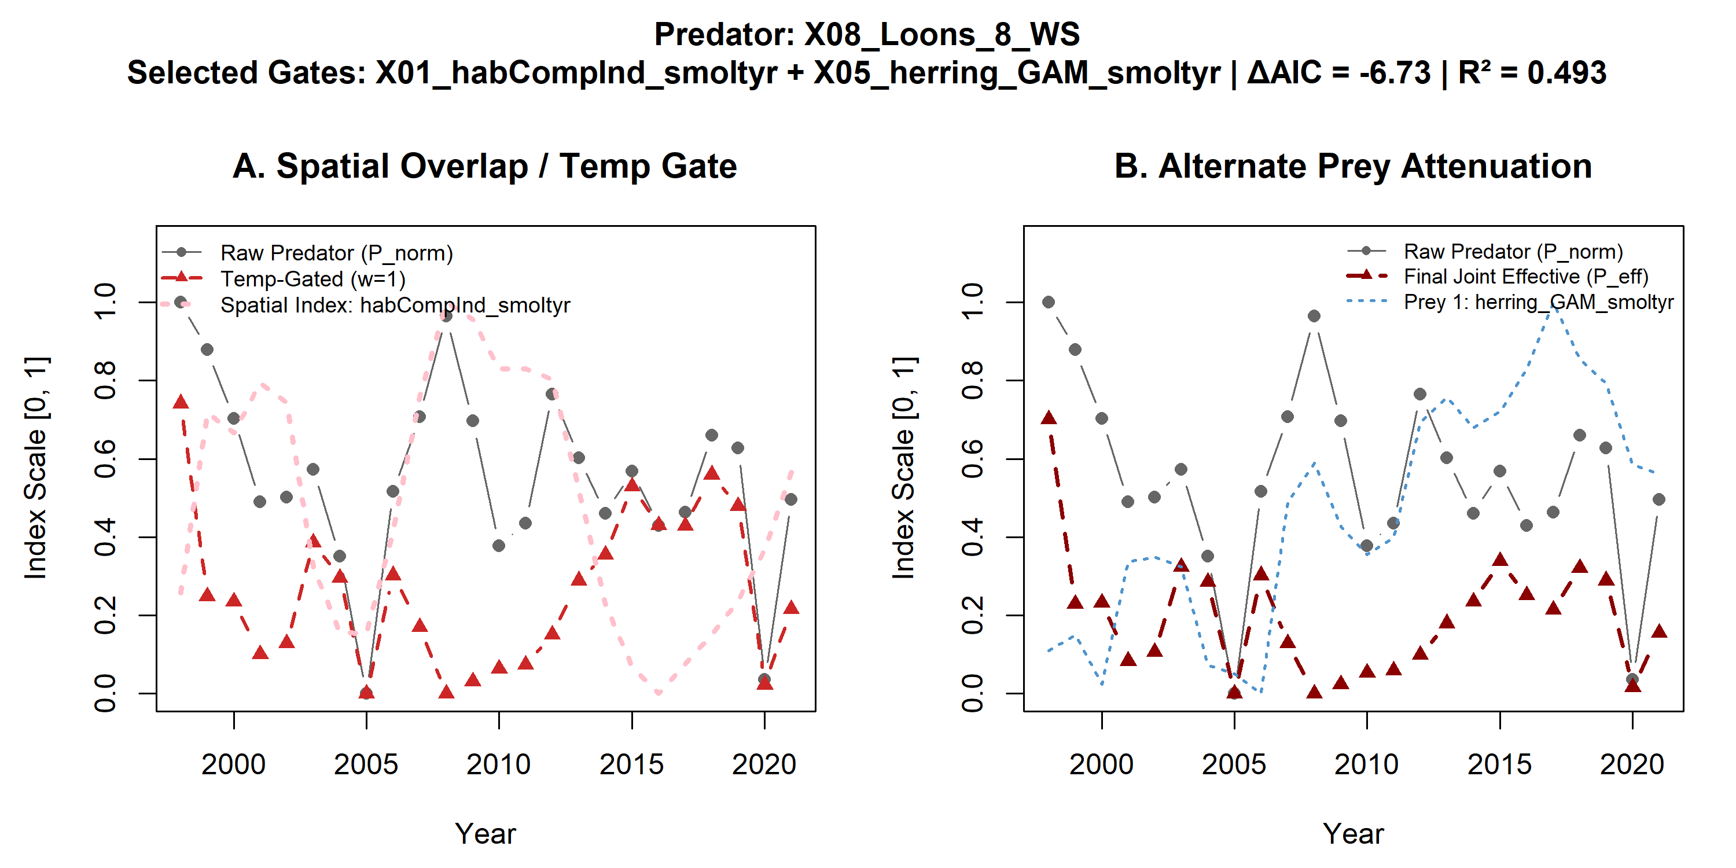
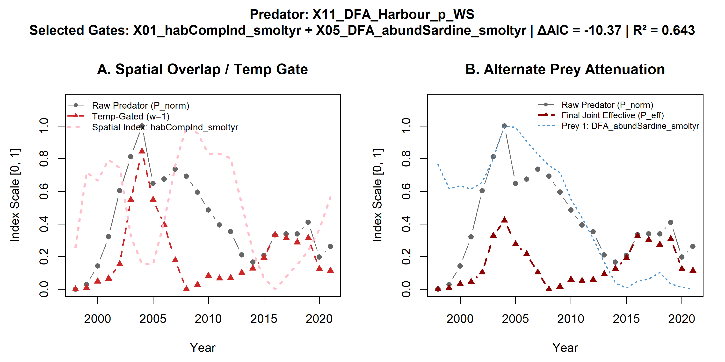
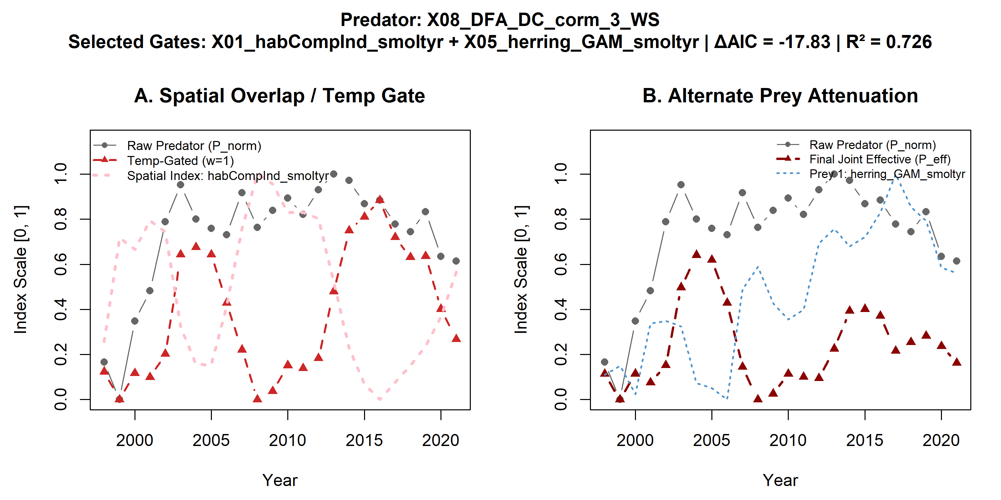
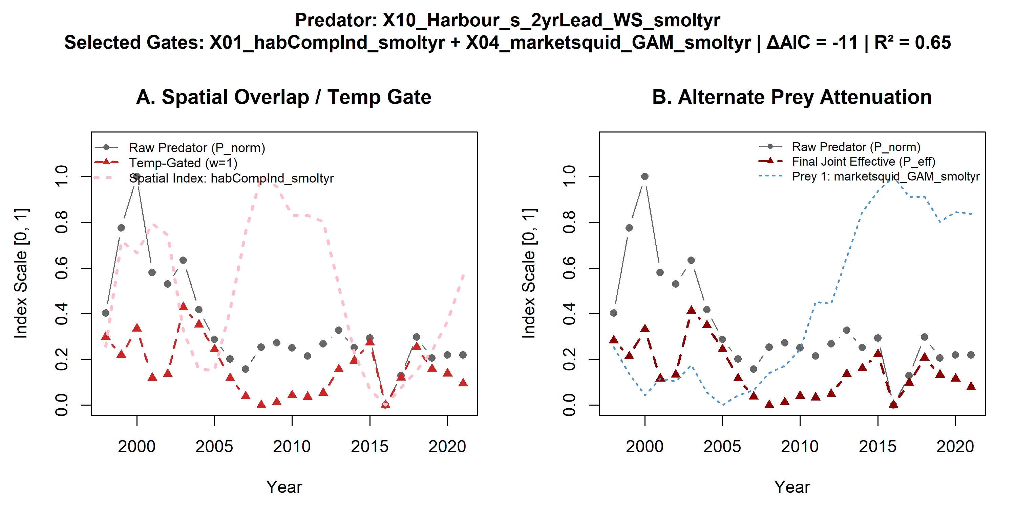
19 yr selected models (daic>6, 12 models)
Birds and mammals

Slide 21
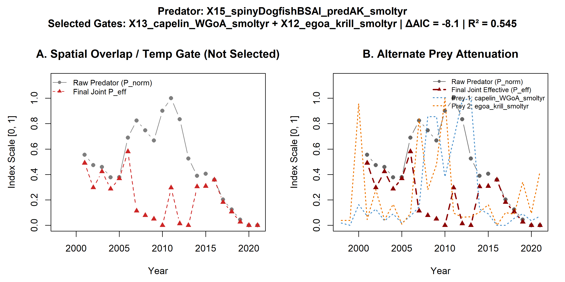
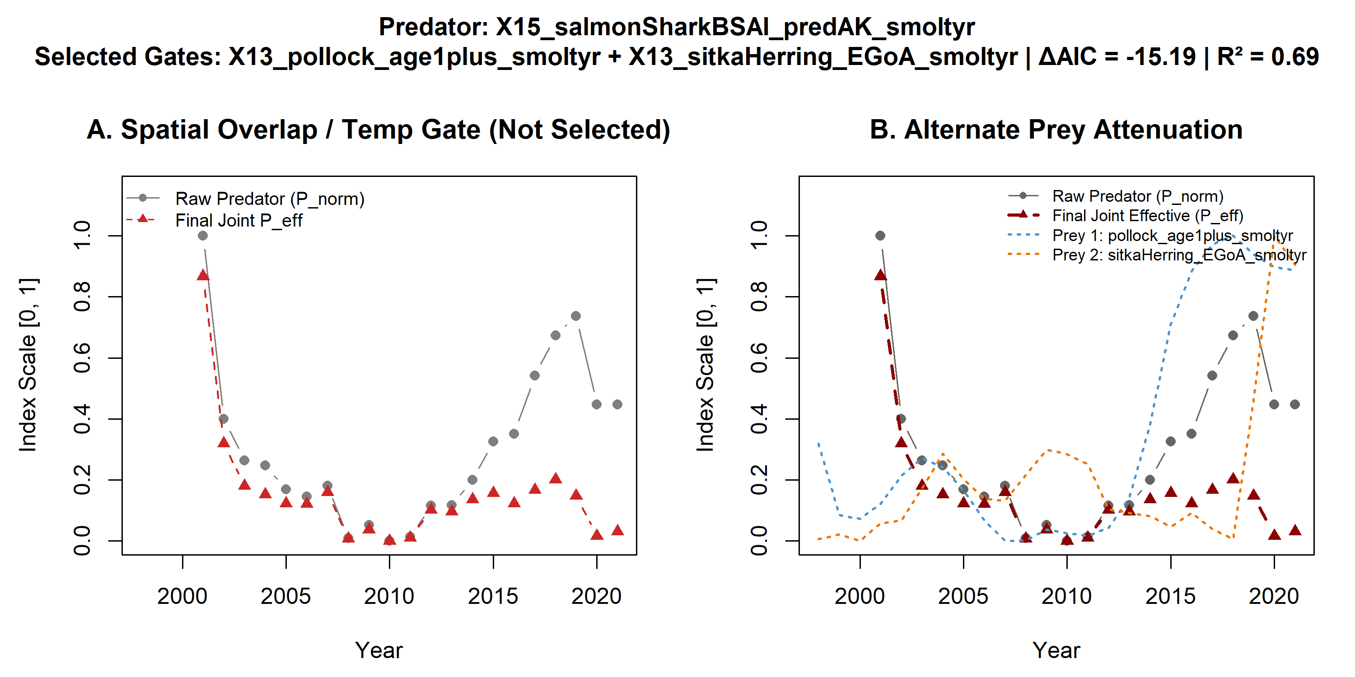


19 yr selected models (daic>6, 12 models)
Fish in smolt year

Slide 22
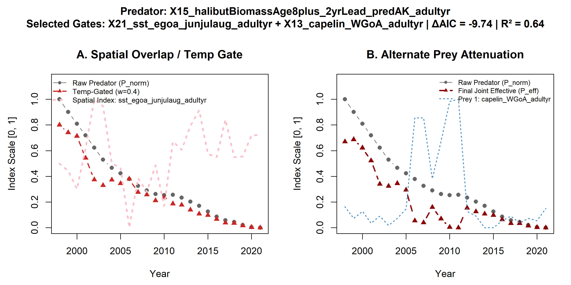
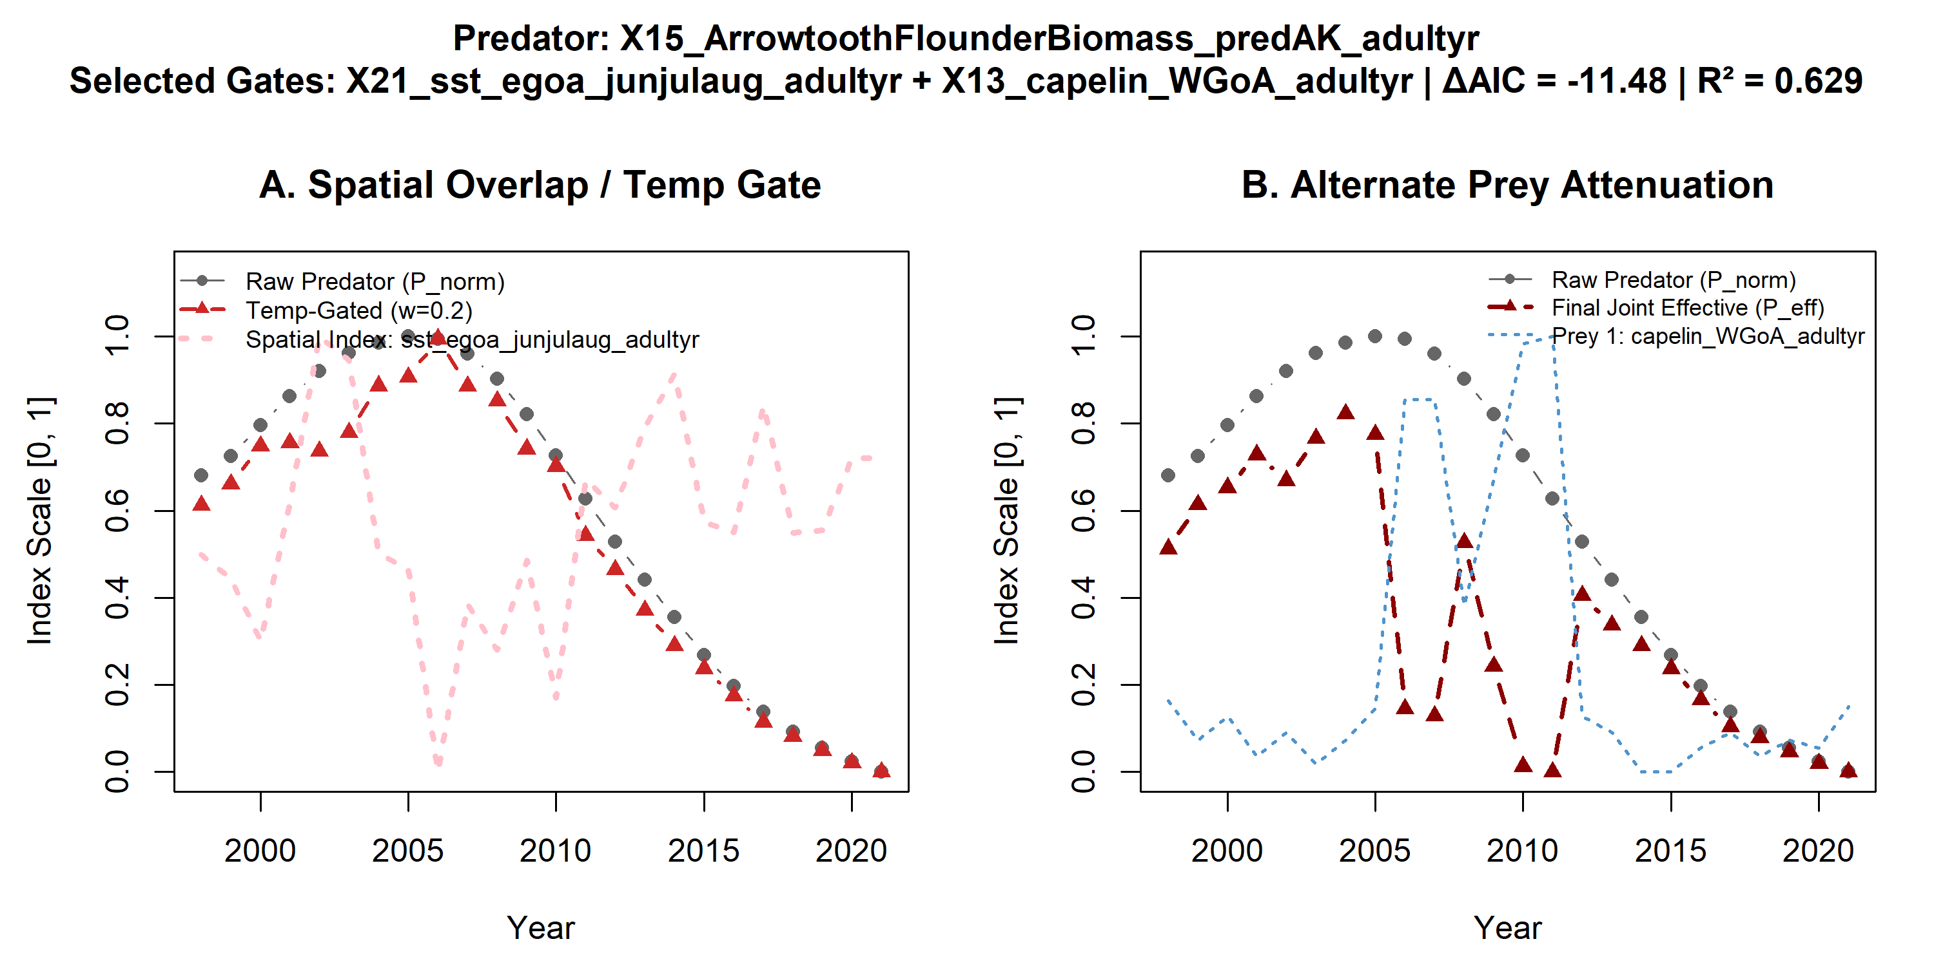
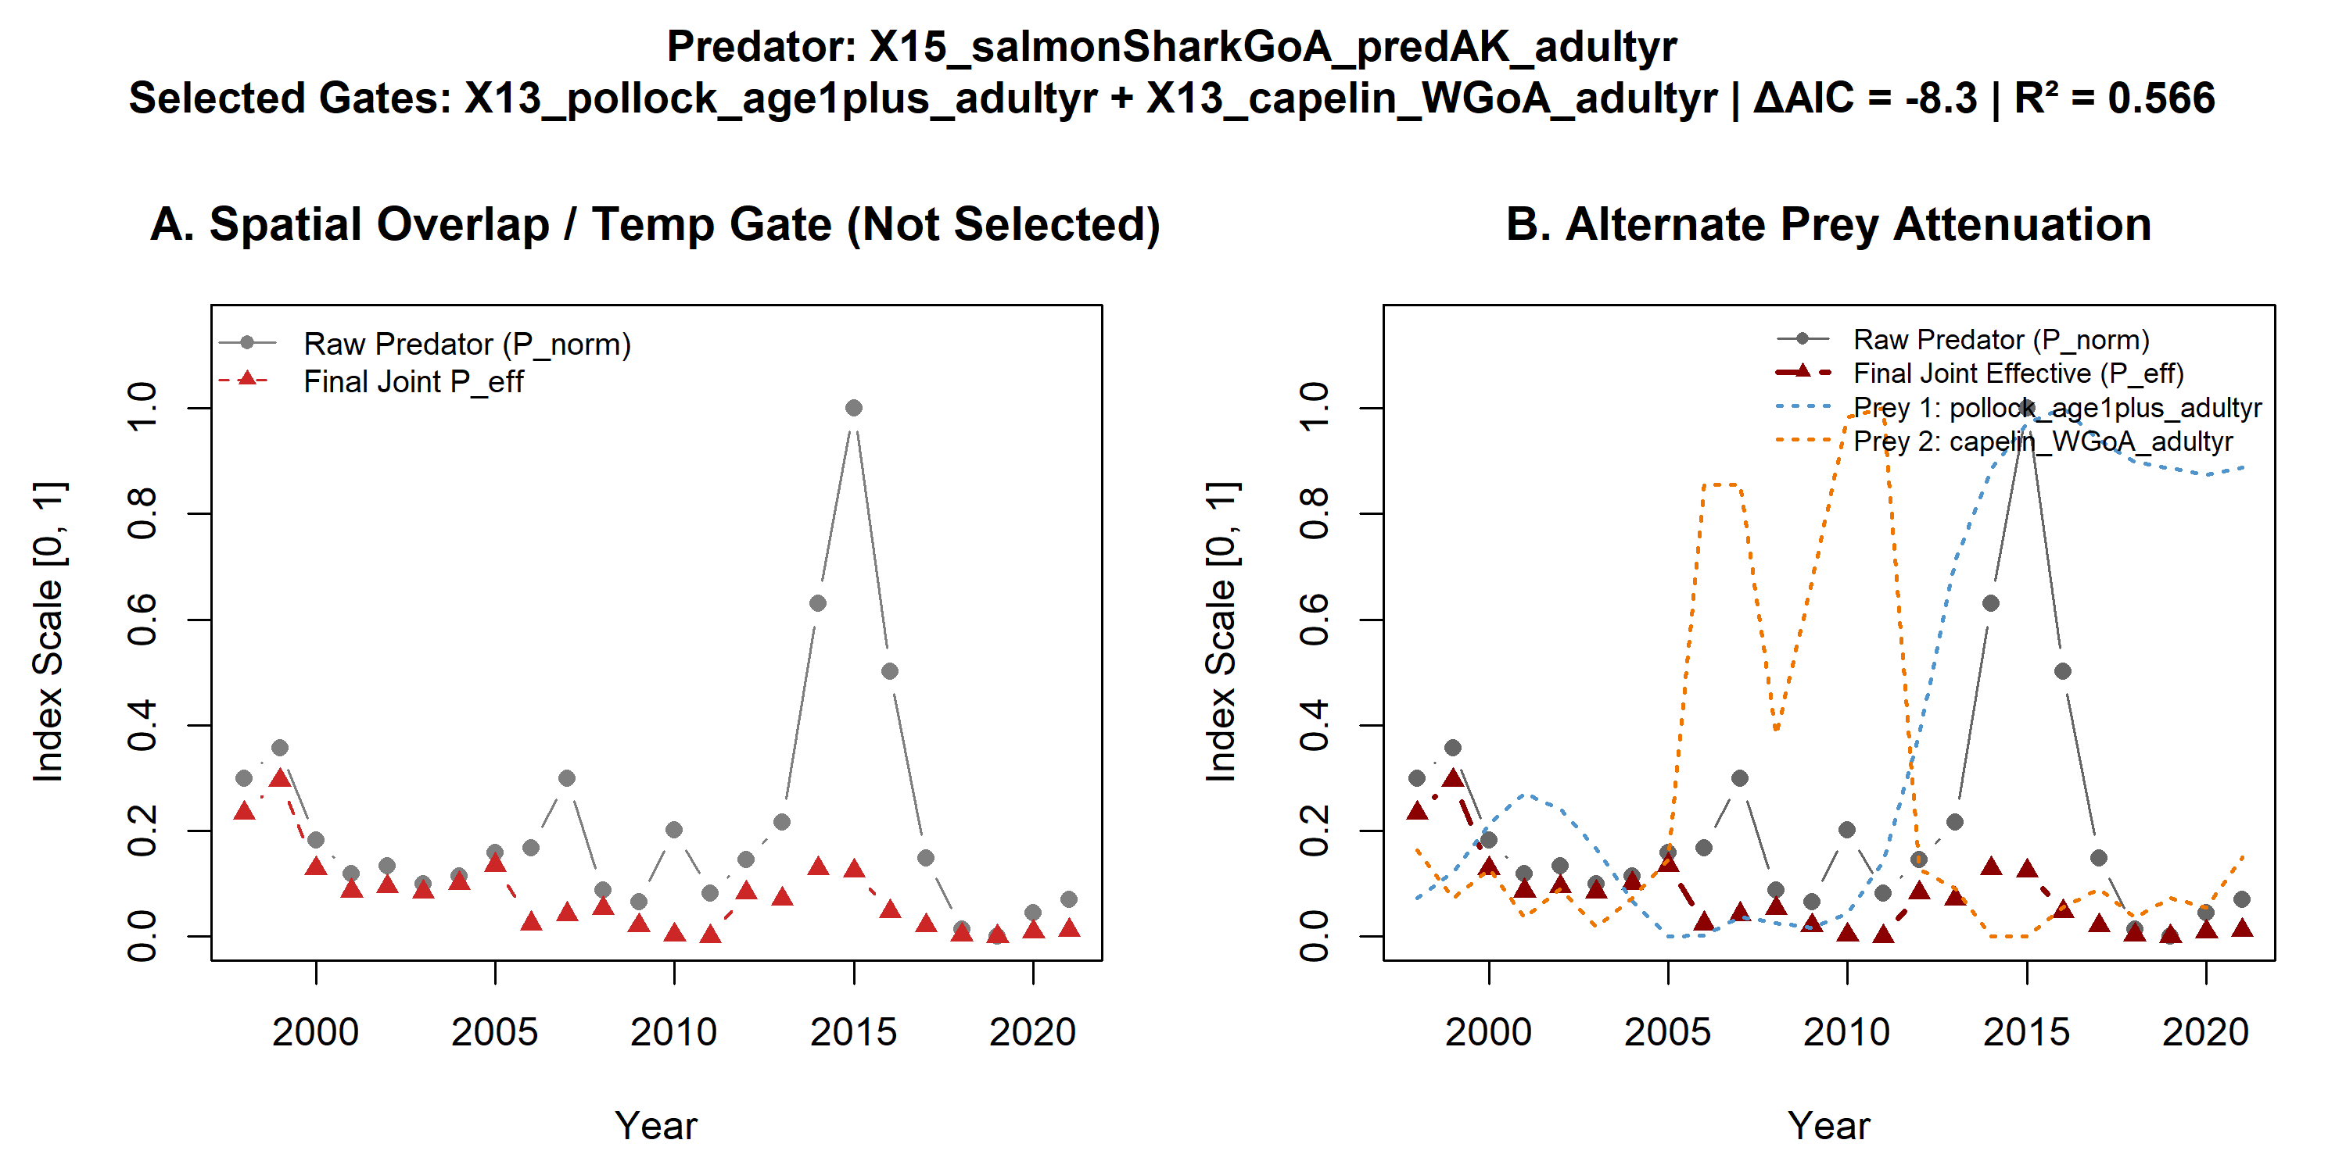
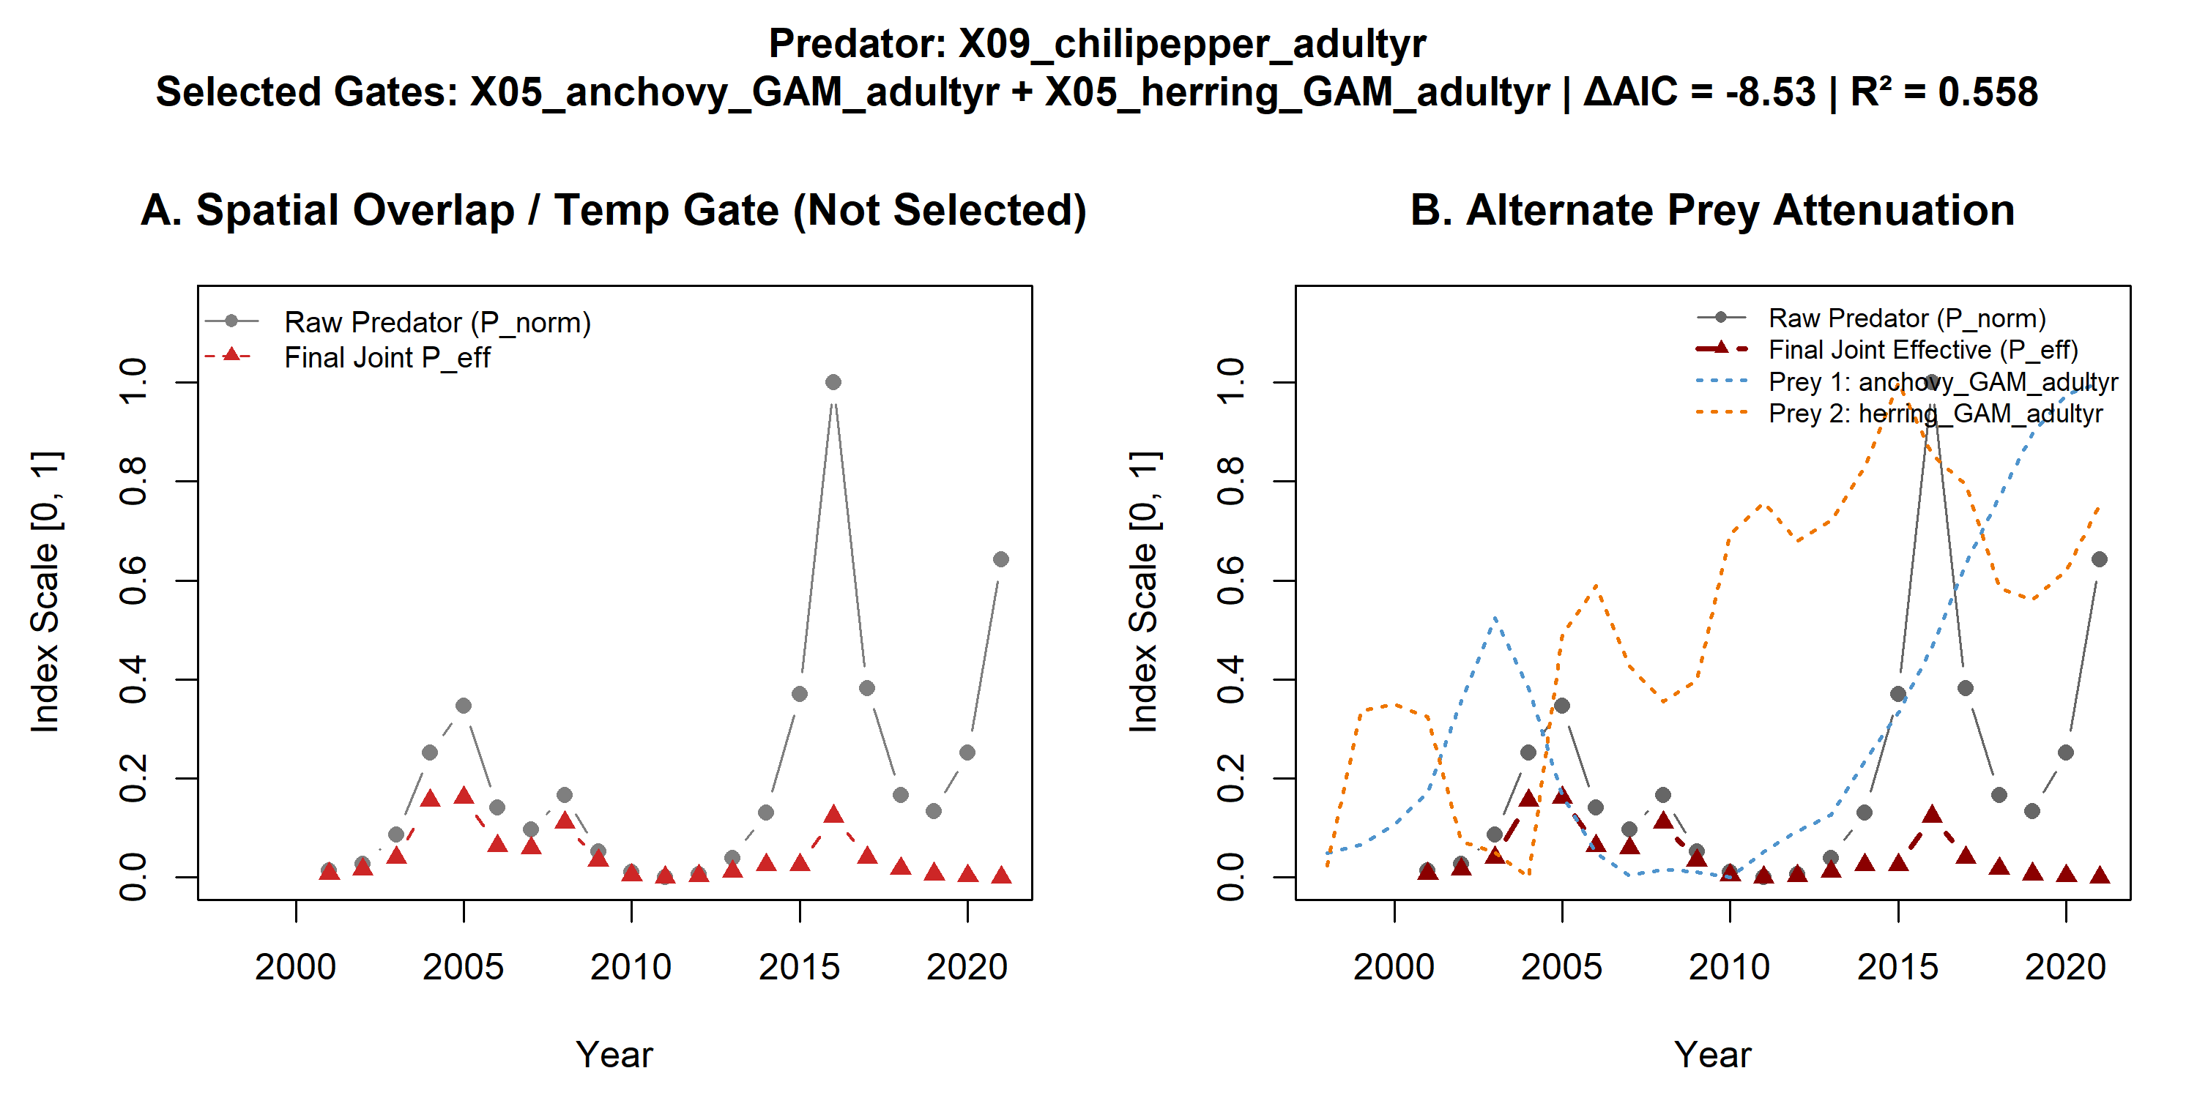
19 yr selected models (daic>6, 12 models)
Fish in adult year

Slide 23
Top models (ak only)
predator | selected_prey | fitted_weights | base_beta | beta_peff | pvalue | mean_net_impact | realized_ damping_pct | aic | base_aic | delta_aic | base_r2 | final_r2 | dataset
X15_ArrowtoothFlounderBiomass_predAK_adultyr | X13_mid_il_capelin_adultyr | 1 | -0.19 | -0.48 | 0.00 | -0.19 | 33.15 | -0.32 | 8.43 | -8.75 | 0.34 | 0.54 | 24-Year Series
X15_sablefishBiomass_predAK_smoltyr | X13_pollock_age1plus_smoltyr + X13_sitkaHerring_EGoA_smoltyr | 0.8; 1 | 0.13 | -2.53 | 0.00 | -0.19 | 70.30 | 2.81 | 9.43 | -6.62 | 0.32 | 0.48 | 24-Year Series
X15_ArrowtoothFlounderBiomass_predAK_smoltyr | X13_mid_il_capelin_smoltyr | 1 | -0.20 | -0.27 | 0.02 | -0.11 | 23.71 | 5.37 | 7.74 | -2.37 | 0.36 | 0.42 | 24-Year Series
X15_sablefishBiomass_predAK_adultyr | X13_pollock_age1plus_adultyr + X13_mid_il_capelin_adultyr | 1; 1 | 0.23 | -1.70 | 0.02 | -0.11 | 69.56 | 5.38 | 8.83 | -3.45 | 0.33 | 0.42 | 24-Year Series
X11_ssl_seak_pup_pred | X13_sitkaHerring_EGoA_smoltyr + X13_mid_il_capelin_smoltyr | 1; 1 | 0.18 | -0.37 | 0.03 | -0.12 | 50.08 | 5.39 | 8.44 | -3.05 | 0.34 | 0.42 | 24-Year Series
X10_DFA_ssl.est.wholerange_2yrLead_smoltyr | X01_habCompInd_smoltyr + X04_marketsquid_GAM_smoltyr | 1; 0.8 | 0.24 | -1.61 | 0.04 | -0.17 | 76.97 | 6.04 | 8.33 | -2.28 | 0.35 | 0.41 | 24-Year Series
X15_salmonSharkGoA_predAK_smoltyr | X13_sitkaHerring_EGoA_smoltyr + X13_mid_il_capelin_smoltyr | 1; 1 | 0.06 | -1.09 | 0.04 | -0.09 | 57.36 | 6.08 | 9.90 | -3.81 | 0.30 | 0.40 | 24-Year Series
X15_sablefishBiomass_predAK_smoltyr | X13_pollock_age1plus_smoltyr + X13_sitkaHerring_EGoA_smoltyr | 0.9; 1 | 0.15 | -7.07 | 0.00 | -0.34 | 82.89 | -6.67 | 10.63 | -17.30 | 0.30 | 0.72 | 19-Year Series
X15_salmonSharkBSAI_predAK_smoltyr | X13_pollock_age1plus_smoltyr + X13_sitkaHerring_EGoA_smoltyr | 0.7; 0.9 | -0.23 | -2.47 | 0.00 | -0.35 | 60.73 | -4.92 | 10.27 | -15.19 | 0.31 | 0.69 | 19-Year Series
X15_halibutBiomassAge8plus_2yrLead_predAK_adultyr | X21_sst_egoa_junjulaug_adultyr + X13_capelin_WGoA_adultyr | 0.4; 1 | -0.38 | -0.96 | 0.00 | -0.18 | 54.26 | -2.04 | 7.70 | -9.74 | 0.40 | 0.64 | 19-Year Series
X15_ArrowtoothFlounderBiomass_predAK_adultyr | X21_sst_egoa_junjulaug_adultyr + X13_capelin_WGoA_adultyr | 0.2; 1 | -0.19 | -0.73 | 0.00 | -0.19 | 49.77 | -1.47 | 10.01 | -11.48 | 0.32 | 0.63 | 19-Year Series
X15_DFA_sleeperSharks_adultyr | X14_pinkSalmonNorthAmerica_adultyr + X13_capelin_WGoA_adultyr | 0.4; 1 | -0.41 | -0.73 | 0.00 | -0.11 | 44.38 | -1.00 | 3.86 | -4.85 | 0.51 | 0.62 | 19-Year Series
X15_salmonSharkGoA_predAK_adultyr | X13_pollock_age1plus_adultyr + X13_capelin_WGoA_adultyr | 0.9; 1 | -0.29 | -3.68 | 0.00 | -0.19 | 76.25 | 1.52 | 9.81 | -8.30 | 0.33 | 0.57 | 19-Year Series
X15_spinyDogfishBSAI_predAK_smoltyr | X13_capelin_WGoA_smoltyr + X12_egoa_krill_smoltyr | 1; 1 | 0.19 | -0.96 | 0.00 | -0.18 | 60.83 | 2.38 | 10.48 | -8.10 | 0.30 | 0.55 | 19-Year Series
X15_halibutBiomassAge8plus_2yrLead_predAK_smoltyr | X13_sitkaHerring_EGoA_smoltyr + X13_capelin_WGoA_smoltyr | 1; 1 | -0.25 | -0.57 | 0.01 | -0.12 | 47.58 | 4.83 | 9.61 | -4.78 | 0.33 | 0.48 | 19-Year Series
X15_ArrowtoothFlounderBiomass_predAK_smoltyr | X13_capelin_WGoA_smoltyr | 1 | -0.25 | -0.38 | 0.01 | -0.11 | 32.47 | 5.32 | 8.97 | -3.65 | 0.36 | 0.47 | 19-Year Series
X15_salmonSharkBSAI_predAK_adultyr | X13_pollock_age1plus_adultyr + X13_capelin_WGoA_adultyr | 1; 1 | -0.19 | -0.71 | 0.01 | -0.07 | 66.16 | 5.44 | 10.56 | -5.12 | 0.30 | 0.47 | 19-Year Series
X15_salmonSharkGoA_predAK_smoltyr | X13_sitkaHerring_EGoA_smoltyr + X13_capelin_WGoA_smoltyr | 1; 1 | 0.03 | -1.38 | 0.01 | -0.10 | 64.99 | 5.63 | 11.22 | -5.58 | 0.28 | 0.46 | 19-Year Series
X15_sablefishBiomass_predAK_adultyr | X13_pollock_age1plus_adultyr + X13_capelin_WGoA_adultyr | 1; 1 | 0.26 | -1.98 | 0.02 | -0.10 | 77.36 | 6.56 | 9.95 | -3.39 | 0.32 | 0.43 | 19-Year Series
X15_PacificCodBiomass_predAK_adultyr | X13_pollock_age1plus_adultyr + X13_capelin_WGoA_adultyr | 0.7; 1 | 0.01 | -0.62 | 0.02 | -0.13 | 59.40 | 6.71 | 11.23 | -4.52 | 0.28 | 0.43 | 19-Year Series
X15_spinyDogfishBSAI_predAK_adultyr | X13_pollock_age1plus_adultyr + X13_capelin_WGoA_adultyr | 0.7; 1 | 0.09 | -0.71 | 0.04 | -0.15 | 58.60 | 7.24 | 11.10 | -3.86 | 0.28 | 0.41 | 19-Year Series

Slide 24
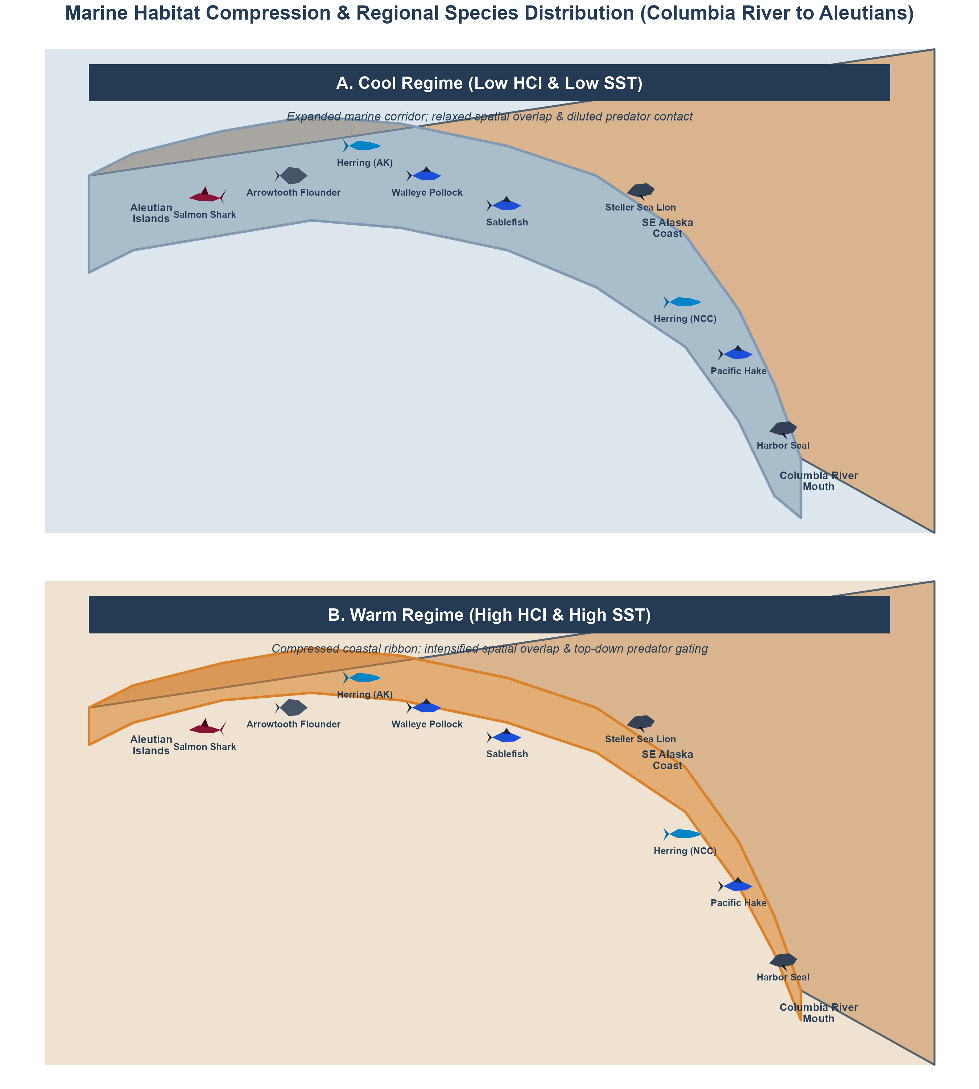

Slide 25
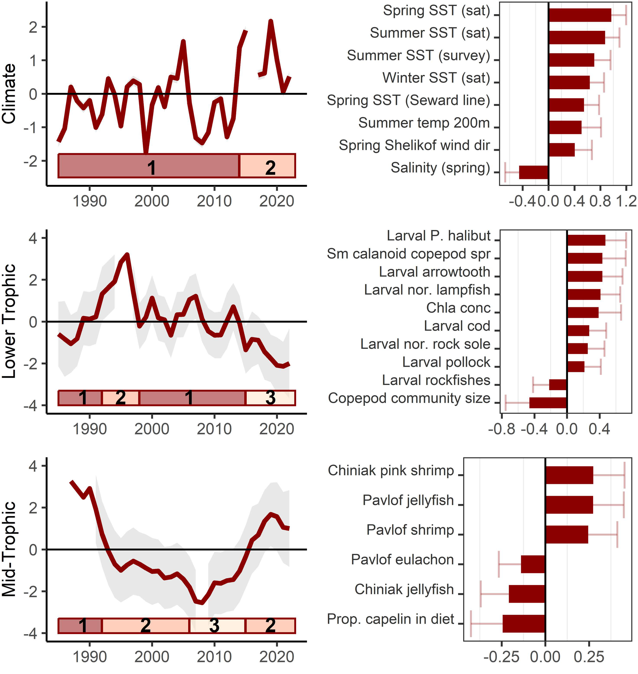
Western (left) and eastern (right) GOA results
non-intuitive results (e.g., the inverse relationships of herring and juvenile salmon).

Slide 26
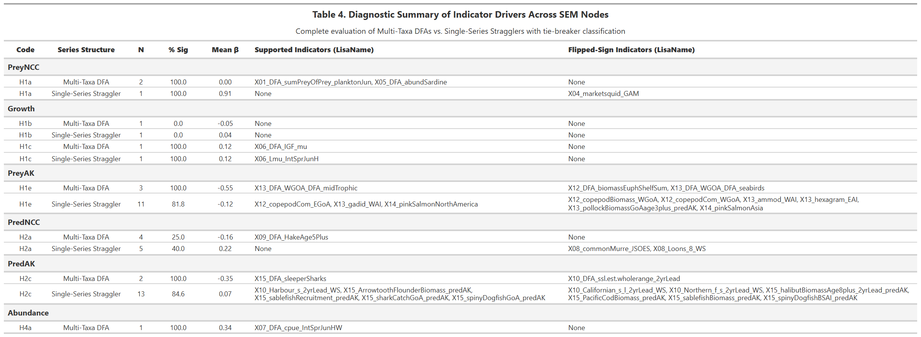
predator | selected_prey | fitted_weights | beta_peff | pvalue | std_eff_beta | mean_net_impact | realized_damping_pct | aic | base_aic | delta_aic
<chr> | <chr> | <chr> | <dbl> | <dbl> | <dbl> | <dbl> | <dbl> | <dbl> | <dbl> | <dbl>
X15_sablefishBiomass_predAK_smoltyr | X13_pollock_age1plus_smoltyr + X12_egoa_krill_smoltyr | 1; 1 | -2.87 | 0.00106 | -0.465 | -0.158 | 78.7 | 1.1 | 9.43 | -8.33
X15_sablefishBiomass_predAK_adultyr | X13_pollock_age1plus_adultyr + X12_egoa_krill_smoltyr | 1; 1 | -2.52 | 0.00116 | -0.463 | -0.14 | 74.6 | 1.21 | 8.83 | -7.63
X10_Harbour_s_2yrLead_WS_adultyr | None (Unattenuated) | None | -0.546 | 0.00685 | -0.41 | -0.181 | 0 | 3.57 | 3.57 | 0
X15_ArrowtoothFlounderBiomass_predAK_adultyr | X13_mid_il_capelin_smoltyr | 1 | -0.32 | 0.0134 | -0.378 | -0.136 | 27.7 | 4.51 | 8.43 | -3.92
X15_ArrowtoothFlounderBiomass_predAK_smoltyr | X13_mid_il_capelin_smoltyr | 1 | -0.27 | 0.0246 | -0.349 | -0.109 | 23.7 | 5.37 | 7.74 | -2.37
X11_ssl_seak_pup_pred | X13_sitkaHerring_EGoA_smoltyr + X13_mid_il_capelin_smoltyr | 1; 1 | -0.366 | 0.025 | -0.378 | -0.122 | 50.1 | 5.39 | 8.44 | -3.05

Slide 27
explanations
Alt prey
Sst
Temporal shift (sablefish recruitment vs total pop) – wrong age class
Spatial shifts

Slide 29
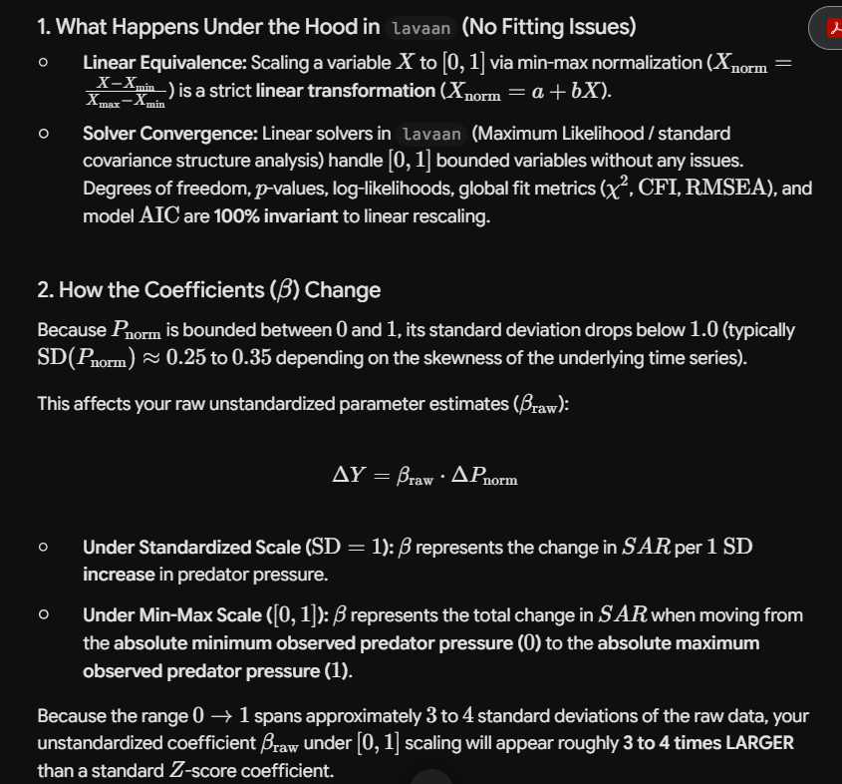
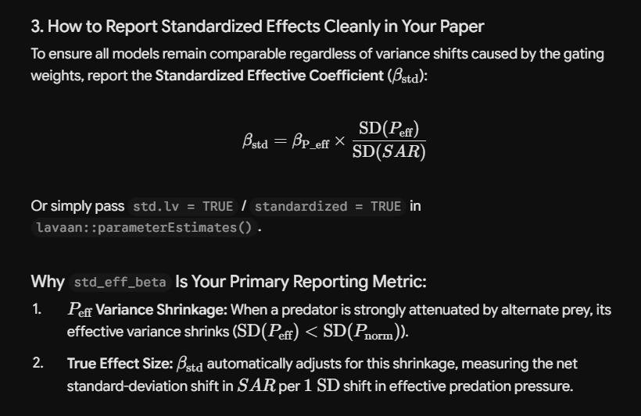

Slide 30
2024 Return
The 2024 upriver spring Chinook return to the Columbia River totaled 116,332 adults (Tables 1 and 5) and consisted of 101,171 Age-4 fish, 14,942 Age-5 fish, and 215 Age-6 fish. The return included 70,743 (10,514 wild) adult Snake River spring/summer Chinook and 18,224 (1,609 wild) adult upper Columbia spring Chinook. The remainder of the run was destined for tributaries in the mid-Columbia area. The 2024 upriver spring Chinook return was 96% of the preseason forecast of 121,000 fish and 76% the recent 10-year average (2014–2023) of 152,289 adults. The 2024 return ranked 21st out of all returns since 1980.

Slide 32
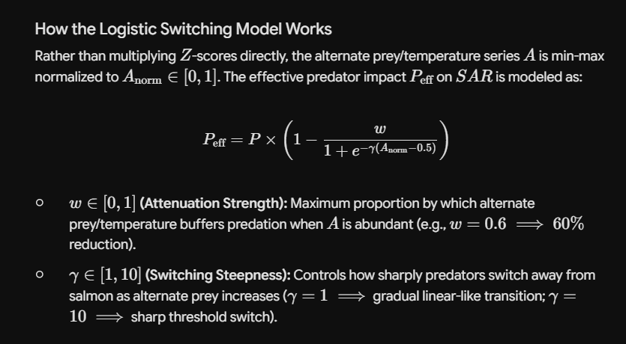
How the Logistic Switching Model Works
Rather than multiplying $Z$-scores directly, the alternate prey/temperature series $A$ is min-max normalized to $A_{\text{norm}} \in [0, 1]$. The effective predator impact $P_{\text{eff}}$ on $SAR$ is modeled as:
$$P_{\text{eff}} = P \times \left(1 - \frac{w}{1 + e^{-\gamma (A_{\text{norm}} - 0.5)}}\right)$$
$w \in [0, 1]$ (Attenuation Strength): Maximum proportion by which alternate prey/temperature buffers predation when $A$ is abundant (e.g., $w = 0.6 \implies 60\%$ reduction).
$\gamma \in [1, 10]$ (Switching Steepness): Controls how sharply predators switch away from salmon as alternate prey increases ($\gamma = 1 \implies$ gradual linear-like transition; $\gamma = 10 \implies$ sharp threshold switch).

Slide 33
